Slide 1
TRANSITS I
Technical Module
Presenter
Location
Date
Authors: Slavo Greminger, Jeffeny Hoogervorst, Antonio Merola, Melanie Rieback, Sven Gabriel. Jeroen van der Ham, Serge Droz, Daniel Roethlisberger, Patric Lichtensteiger, Silvio Oertli, Don Stikvoort.
Version: 7.1.
This work is licensed under a Creative Commons Attribution-NonCommercial-ShareAlike 4.0 International License.
Notes:
The video slides are placeholders and hidden by default. The slides can be unhide by the teacher if he or she wants to use the video.
The images must be replaced by the video’s from the directory “SupportingVideos”.
So don’t delete them!

Slide 2
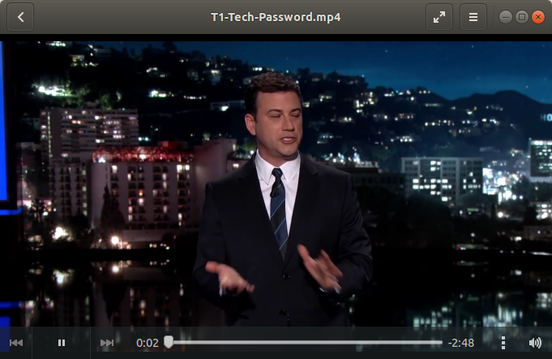
Intro
Video available at: https://www.youtube.com/watch?v=opRMrEfAIiI. Please check that this is still publicly available before using and embed here.
To unhide slide, click ”slide show” in top navigation bar. Delete this note.
2
Notes:
Optional: play video in the movie folder.
T1-Tech-Password.mp4
Jimmy Kimmel on Passwords (2015)
Video duration: 2:49
Funny story about passwords, has also an element of social engineering, i.e. make people tell you their password.
Or alternatively
Funny video about the cloud (July 2018)
T1-Tech-Cloud.mp4
Video duration: 5:07

Slide 3
Session Plan
Part I Threat Landscape
Introducing terms in context of ENISA’s Threat Landscape
Underground economy
Part II Malware Techniques
Malware classes and functionality
Part III Hacking Tools and Techniques
Hacking techniques
Abbreviations
Part IV Defense and Mitigation
Think as incident responder
3
Notes:
Part I: introduce terms such as threat and threat agents in the context of ENISA’s Threat
The notion of Underground Economy is introduced and illustrated → guide to build a Crime-as-a-Service.
Part II: make the trainees familiar with malware classes and functionality.
Malware actors need
a) an easily manageable and resilient technical network infrastructure
b) an efficient (and effective) host infection mechanism.
Part III: give a feeling what hacking actually is.
A few standards, such as
Common Platform Enumeration (CPE),
Common Weakness Enumeration (CWE)
Common Vulnerability and Exposure (CVE)
Common Vulnerability Scoring System(CVSS)
Part IV: Think as incident responders
These two threats are repeatedly used throughout this module.
It is crucial to stress the importance of a community, the very reason of TRANSITS I. Without, a takeover of the Gameover Zeus botnet (Operation Tovar) would not have been possible.

Slide 4
Part I Threat Landscape

Slide 5



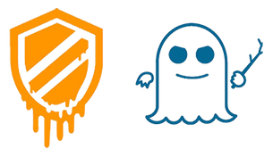


Threat Landscape - Threats
What are cyber threats?
Who has ever become a victim of a cyber threat?
Group Discussion
5
Notes:
Malware logos, from left to right:
- Meltdown - https://en.wikipedia.org/wiki/Meltdown_(security_vulnerability)
- Spectre - https://en.wikipedia.org/wiki/Spectre_(security_vulnerability)
- Black Nurse - https://en.wikipedia.org/wiki/BlackNurse
- Shellshock - https://en.wikipedia.org/wiki/Shellshock_(software_bug)
- Heartbleed - https://en.wikipedia.org/wiki/Heartbleed
- Poodle - https://en.wikipedia.org/wiki/Shellshock_(software_bug)
Ask them about Heartbleed and Shellshock.
Ask them about the difference between traditional threats and cyber threats.
For the rest of the module, we omit the term cyber and talk about threats only.
Victim of a cyberthreat (DDoS, Skimming, ID-Theft, else)
Images used under fair-use.

Slide 6
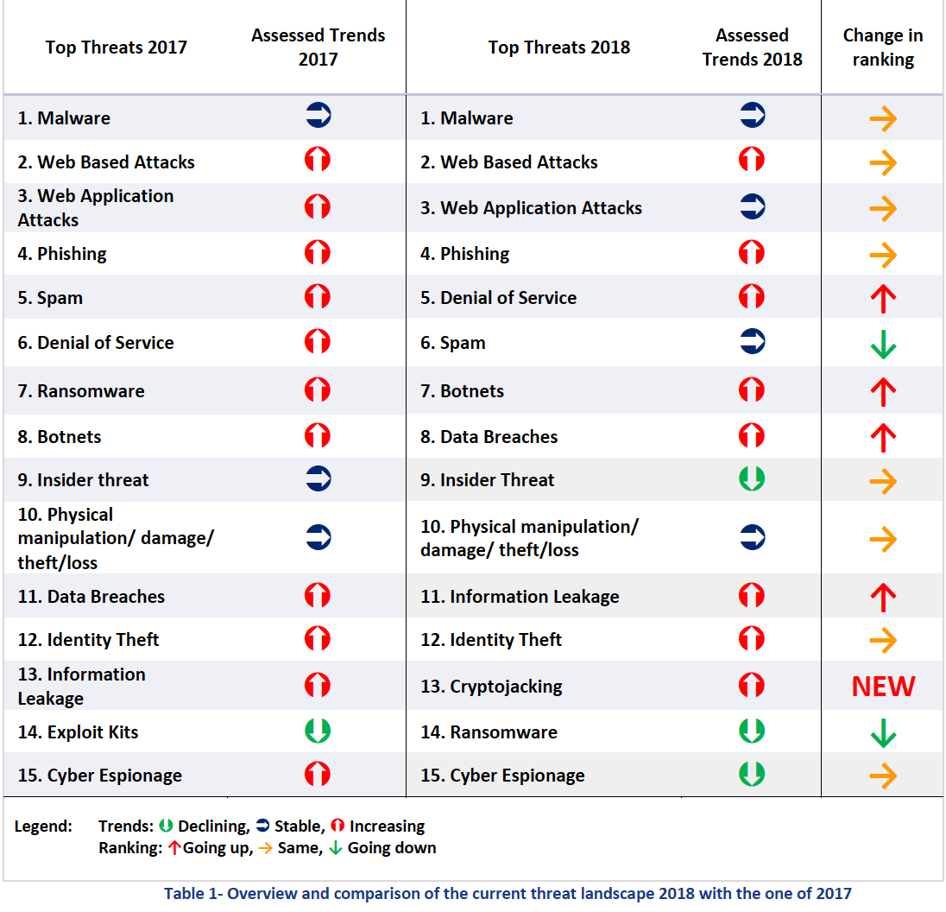
Threat Landscape - Threats
Source: ENISA Threat Landscape 2018,
used with permission from ENISA.
© European Union Agency for
Network and Information Security
(ENISA), 2018
https://www.enisa.europa.eu/
publications/enisa-threat-
landscape-report-2018
6
Notes:
know all terms
Make sure that they know what a Botnet is
introduce the terms botnet, bot herder and bot a.k.a zombie
To update every year.
https://www.enisa.europa.eu/topics/threat-risk-management/threats-and-trends/enisa-threat-landscape

Slide 7
Threat Landscape – Threat Agents
Cyber Criminals
Cyber Terrorists
Cyber Fighters
Hacktivists
Companies / Corporations
Governments / States
Employees
Script Kiddies
7
Notes:
Goal: Motivation behind attacks.
All about Money Underground economy
Terms may trigger discussions, for an overview check CyberAgents.png, or original enisa doc.
ENISA talks about Cyber Agents,
the latter called threat agents. A few examples:
Cyber Criminals:
Blackmailing people with pictures taken by their webcam
Blackmailing companies through ransomware
Cyber Terrorists:
Syrian Electronic Army: Hack of Twitter / Huffington Post hack, NYTimes
(http://archive.thedailystar.net/beta2/news/new-york-times-twitter-hacked-by-syrian-group/)
Cyber Fighters:
Cyber fighters of Izz Ad-Din Al Qassam
(http://en.wikipedia.org/wiki/Operation_Ababil)
Hacktivists: Anonymous LulzSec
Anonymous publishes drops of databases containing credentials
Employees: Fired system administrator
Fired system administrator uses existing accounts or backdoors to bother
the “new guy”
Script Kiddies:
14 year old doses his high school with a downloaded tool

Slide 8
Threat Landscape – Targeted Attacks (APT)
Advanced
Specific target and goal;
Full spectrum of various techniques for intelligence gathering, including wiretapping, and computer intrusion.
Persistent
Long duration (up to years);
‘Low and slow’ approach.
Threat
Complex and effective attack on high-profile targets:
Governments.
Multinational companies / organizations.
Result of attack is significant: huge losses.
8
Notes:
Let’s do a APT, what do we need? On Flipchart
From a structural point of view, Penetration Testing is quite similar (see PTES Guidelines)
Use Elements from Threat Landscape to built an APT, like: Phishing to get an account/foothold etc. at the end it could be cyberespionage

Slide 9
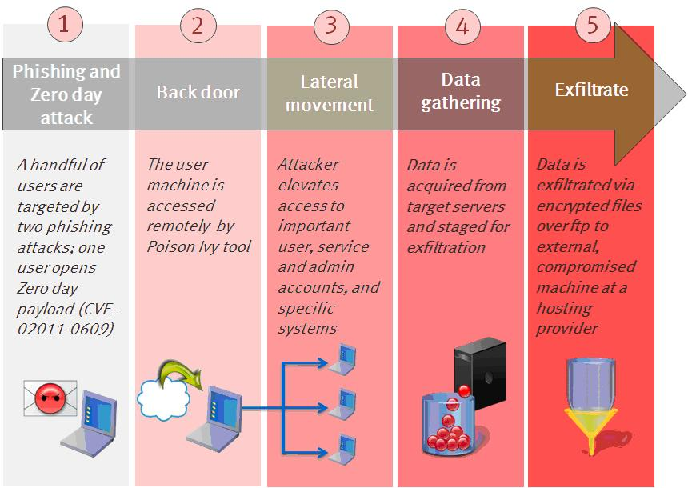
Threat Landscape – Targeted Attacks (APT)
Image released by RSA in 2011 in a blogpost describing an Adobe Flash exploitation. Blogpost no longer published. © RSA
9
Notes:
1. A task is defined, accomplices found, tools built and/or acquired, target researched. Initial intrusion started: Phishing and Zero day attack.
2. Outbound connection initiated: Poison Ivy for remote access.
3. Access expanded and credentials obtained: Lateral movement with various tools.
4. Foothold is strengthened and data gathered: locally still, with various tools.
5. Data is exfiltrated: slow and low, below the radar.
6. Tracks should be covered and ensure that attack remains undetected.

Slide 10

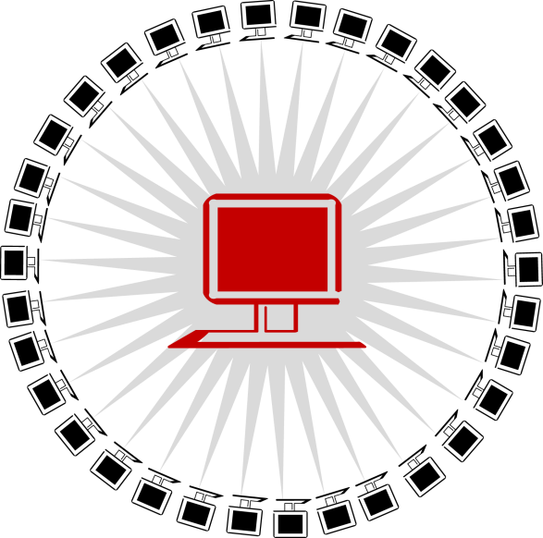
Threat Landscape – Botnet
Botnet: foundation of many threats
infected machines, called bots or drones or zombies
remotely controllable by an entity called bot herder
centralized (IRC,HTTP) or decentralized (P2P)
10
Notes:
Introducing Botnet
https://www.youtube.com/watch?v=jWnExuf4NOY

Slide 11
Threat Landscape – Underground Economy
Various ways to earn money as a bot herder
as an Actor e.g. by mining bitcoins on your bots
as a Service Provider e.g. by distributing Malware for 1$ per installation e.g. by renting your botnet to someone e.g. by sending spam on behalf of a spammer
Various ways to earn money as a spammer
as a Service Provider e.g. by sending advertisements and scams e.g. by sending malware e.g. by sending links to drive-by sites / phishing sites
11
Notes:
‘From bot herder to spammer, from spammer to translators, ...’, this is a huge ecosystem. Transactions between these players usually avoid taxes and thus are illegal. The services/products themselves may or may not be illegal
Motives to trade in the black market:
- to trade contraband(smuggling) (in most countries this included drugs and weapons)
- to avoid taxes
- to skirt price controls

Slide 12
Threat Landscape – Underground Economy
Definition of underground economy:
“ Underground economy or black market is the market in which goods or services are traded illegally. More precisely, the transaction itself is illegal, not necessarily the goods or services.”
Various types of people one would not think of are involved: money mules, translators, hotline operators, video creators etc.
12
Notes:
It's good to discuss the concept of money mules here: both in the sense
of kids withdrawing money from ATMs using stolen cards and sending that
money through to attackers (after taking a cut), or folks accepting and
forwarding money transfers through their bank accounts.
Sites like fiverr.com are used for creating videos and voiceovers (like
Gwapo).

Slide 13

Threat Landscape – [DR]DoS
A Denial of Service attack aims to disrupt the availability of a service such as a machine or network resource by:
flooding
bandwidth
number of connections
…
crashing the service
Nowadays also known as stress tests
13
Notes:
Introduce term Denial of Service attack.
Play video in the Movie Folder
(placeholder image “service or scheduled attack”
Play video: T1-Tech-DDoS.mp4

Slide 14
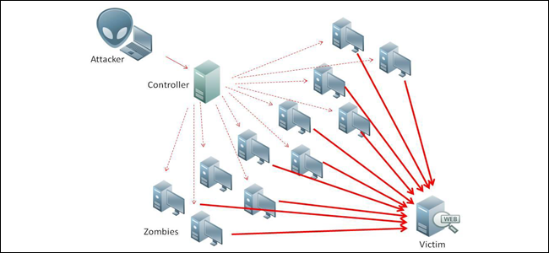
Threat Landscape – [D]DoS
Distributed Denial of Service attack
Source: howtogeek.com, copyright unknown
14
Notes:
https://www.howtogeek.com/wp-content/uploads/2016/11/ddos-650x300.png. Used in various locations online, original copyright unknown.
Explain concept of a ddos

Slide 15

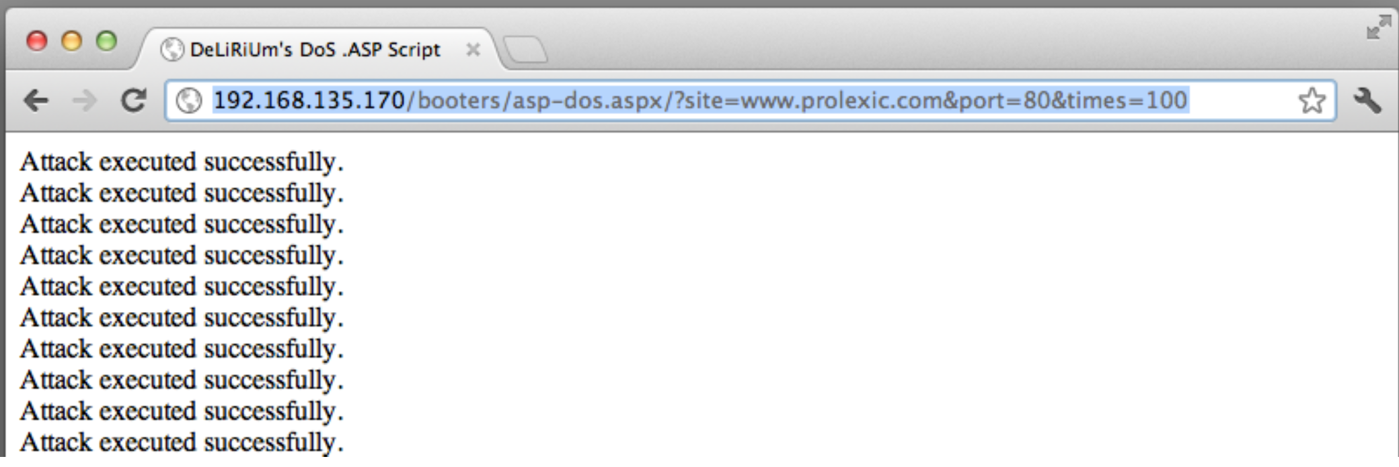
Threat Landscape – [D]DoS
Distributed Denial of Service attack
Booters are on the rise
A booter shell script is a PHP/ASP/Perl script with the functionality of sending floods of traffic. It is typically hosted on an (innocent) website.
Image: © Prolexic, screenshot from Threat Advisory GSI ID - 1050
15
Notes:
Rather than using zombies, (hacked) webservers can be used as well:
booter shell scripts can be “programmed” to flood a target for a certain amount of time.
If one of these booter scripts on a (compromised) website is known, it is a DoS attack; if more of them are known, it is a DDoS attack:
DoS = Denial Of Service = Attack from 1 source computer or connection
DDoS = Distributed Denial Of Service = Attack from multiple source computers or connections.
Screenshot from http://ww1.prweb.com/prfiles/2012/04/24/9438887/Prolexic%20Threat%20Advisory%20DDoS_Booter%20Scripts_041912.pdf. Screenshot from a popular hacker forum.

Slide 16
Threat Landscape – [DR]DoS
Distributed Reflection Denial of Service attack
No need for a botnet, just use existing servers with UDP services.
Some services can be misused because they amplify the request: DNS, NTP, SNMP, … 1 small query in, 1 large answer out
This misuse can be avoided by disabling specific options or implementing firewall rules.
Typical amplification factors
DNS: 28 to 54
NTP: 556.9
Memcached: 10.000 to 51.000
16
Notes:
distributed reflected DoS, is very effective
not only there is no need for a botnet or booter shell scripts,
but also often there is an amplification factor involved.
“disabling specific options” = disabling functions such as the NTP monlist command.
Monlist= get the host connected to the service
“implementing firewall rules” = disallow connections to services from the “outside”.

Slide 17
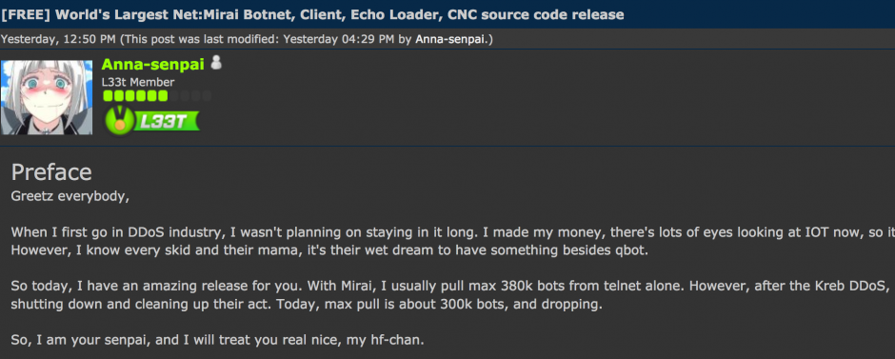
Threat Landscape – [D]DoS Keeps Getting Bigger
The Mirai botnet targeted OVH and security blogger Brian Krebs, at 901/623 Gbps respectively. Akamai drops protecting Krebs - it's too expensive
What's interesting: Mirai exploited IoT devices – insecure webcams, DVRs, and cable modems
1.2 Tbps attack against DYN (DNS company) bogged down the internet – affected Amazon, Netflix, Paypal, Reddit. DDoS now clearly puts the Internet itself at risk
Images from: https://krebsonsecurity.com/2017/01/who-is-anna-senpai-the-mirai-worm-author/
17
Notes:
Images from: https://krebsonsecurity.com/2017/01/who-is-anna-senpai-the-mirai-worm-author/
Good background reading:
https://www.wired.com/story/mirai-botnet-minecraft-scam-brought-down-the-internet/

Slide 18
Threat Landscape – [D]DoS Keeps Getting Bigger
The world was then shocked by a 1.35 Tbps attack against Github, which used Memcached as a reflector (50,000x amplification).
The largest attack (as of Mar 2018) is now 1.7 Tbps. This was also using Memcached.
Attacks are also multi-vector - combining multiple attack techniques into a single DDoS.
18
Notes:
Images from: https://hotforsecurity.bitdefender.com/blog/world-record-broken-again-ddos-attack-exceeds-1-7-terabits-per-second-19653.html
Good background reading: https://www.wired.com/story/mirai-botnet-minecraft-scam-brought-down-the-internet/

Slide 19

Threat Landscape – Botnet
Botnet: foundation of many threats – but why?
…because a lot of money can be made
Click Fraud
Spam / Phishing
Malware Distribution
ID-Theft (B-day, credentials, CC)
APT jumphost
Proxies
DDoS
19
Notes:
A botnet operator has many ways to monetize his botnet:
- Click Fraud: Many advertisement companies exist, who act as a middleman: after a click on an ad, the advertiser pays them, who in turn pay the publisher of the ad, e.g. a web site owner. This is a complex ecosystem, but in a nutshell: with each click, several brokers earn money, paid by the advertiser.
- Spam / Phishing: By sending spam / phishing on behalf of a third, money can be easily made.
- Malware Distribution: By enabling the bots to download more malware, distribution is easy (example: Gameover Zeus downloads Cryptolocker, Pushdo, …)
ID-Theft: Databases with PII (Personally identifiable information), such as name, birthday, social security number, but also credentials and credit card numbers can be sold – just enable the bots to grab this kind of information.
APT jumphost: large botnets may have bots in high-profile targets, such as government and multinational organisations. These bots can be made available to third party groupd for a fee
- Proxies: Proxies are needed for a lot of fraud operations. They can be sold to thirds.
- DDoS: Bots can be easily enable to perform DDoS attacks. Third parties are interested in this kind of service and pay for it.

Slide 20
Threat Landscape – CaaS
To fight crime we need to think like a criminal…
Crime as a Service
A Business Model: World’s Largest Spammer
advertisements and scams
malware
links to drive-by sites / phishing sites
20
Notes:
The story is: “We want to be the world’s largest and best spammer. We are better than the others because
- best price (all claim that)
- segmented recipient list (recipients with regards to some attributes (likes cars, likes shoes, lives in Switzerland, …)
- 99% bypass of filters guaranteed

Slide 21
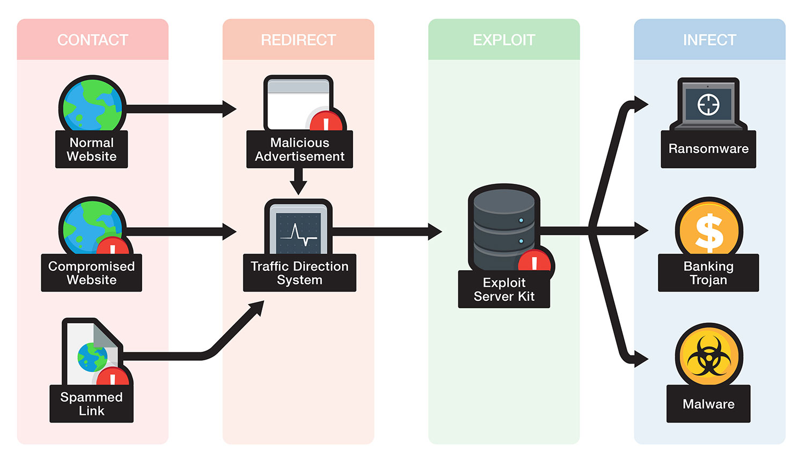
Threat Landscape – Exploit Kit
21
Image: © Trendmicro: https://documents.trendmicro.com/images/tex/articles/exploitkit-figure-1.jpg
Notes:
https://documents.trendmicro.com/images/tex/articles/exploitkit-figure-1.jpg
It is a collection of exploits for managing a variety of exploits altogether; easy to use doesn’t require much technical knowledge.
The exploit kit gathers information, finds vulnerabilities and delivers the exploit, executing malware.
The victim visits a website that has been compromised.
The victim is redirected through various commanded and controlled servers.
The victim reaches the malicious server hosting the exploit kit.
The exploit kit gathers information on the victim and determines the exploit to deliver, thus the exploit is delivered.
If exploit succeeds, a malicious payload is downloaded to the victim’s computer and executed.

Slide 22
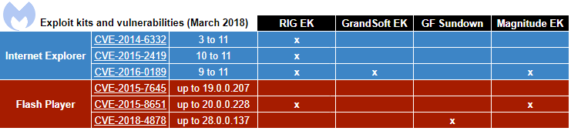
Threat Landscape – Exploit Kit Examples
RIG EK is by far the most popular exploit kit these days, with many different distribution campaigns carring several different payloads. Others well known EK:
GrandSoft EK
GreenFlash Sundown
Magnitude EK
Image © Malwarebytes, use under terms of service: https://www.malwarebytes.com/tos/
22
Notes:
https://en.wikipedia.org/wiki/Exploit_kit
Image link:
https://blog.malwarebytes.com/wp-content/uploads/2018/03/CVEs.png

Slide 23
Threat Landscape – Malvertisement
Case Study: Yahoo! Malvertisement
23
Notes:
Case Study of the Yahoo! Malvertisement which infects 27’000 Infections / hour

Slide 24

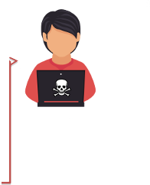


Threat Landscape – Malvertisement
ad with iframe
192.133.137.0/24
Magnitude EK
193.169.256.73/78
24
Notes:
0. An adversary uses CVE-2013-7149 (assumed) to get access to Yahoo! Advertising Server (Software: OpenX/Revive) and places malicious ads
1. A user connects to Yahoo! Mail.
2. Yahoo! Mail presents Advertisements provided by Yahoo! Advertising: The malicious ads contain iframes hosted on some 192.133.137/24 subnet.
3. The user’s browser loads the iframe from 192.133.137/24, gets redirected to 193.169.256.78, which hosts the Magnitude EK.
In the beginning of the campaign, the EK was hosted on 193.169.256.73.
4. The user gets infected by a Java exploit with malware: no clicks needed!

Slide 25
Threat Landscape – Malvertisement
2013-12-29 19:14 UTC 2014-01-03 17:15 UTC according to bluecoat
Yahoo! Mail has 300’000 hits/h 27’000 infections/h based on a 9% infection rate
Magnitude Exploit Kit 9% infection rate
CVE-2012-0507 (Java, patched February 2012) Java Atomic, works up to Java 6u30, 7u2
CVE-2012-4681 (Java, patched August 2012) Java Gondvv / Gondzz, works up to Java 7u6
~ 3 Million Infections (in 5 days)
25

Slide 26
Threat Landscape – Paunch
Case Study: Arrest of Paunch
26
Notes:
Being a criminal does not pay off

Slide 27
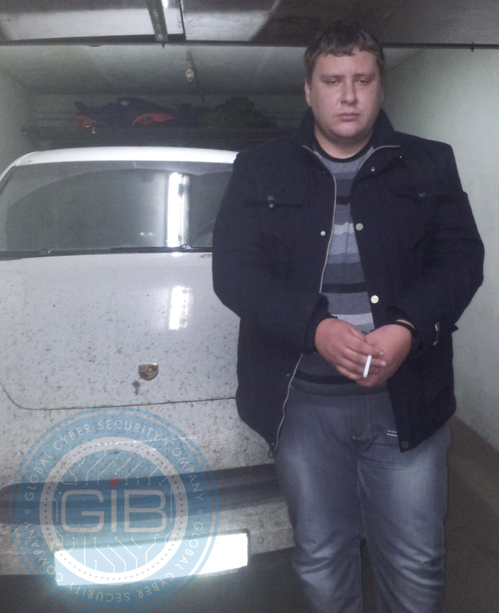
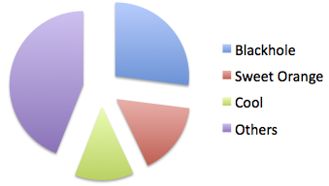
Threat Landscape – Arrest of Paunch
Who is Paunch?
Author of the BlackHole Exploit Kit, which was available for about 500$ / month.
Author of the Cool Exploit Kit, which was privately available for 10’000$ / month. It included exclusive zero-days.
Creator of Crypt.Am, a service that created FUD files
May 2013
Income: 50’000$ / month
Car: Porsche Cayenne
Image Source. https://krebsonsecurity.com/2013/12/meet-paunch-the-accused-author-of-the-blackhole-exploit-kit/
27
Notes:
Paunch was one of the big ones: Blackhole EK, Cool EK
Crypt.am allowed you to automatically modifiy a binary in such a way that it evades every AV engine (for a while)
FUD = Fully UnDetectable

Slide 28
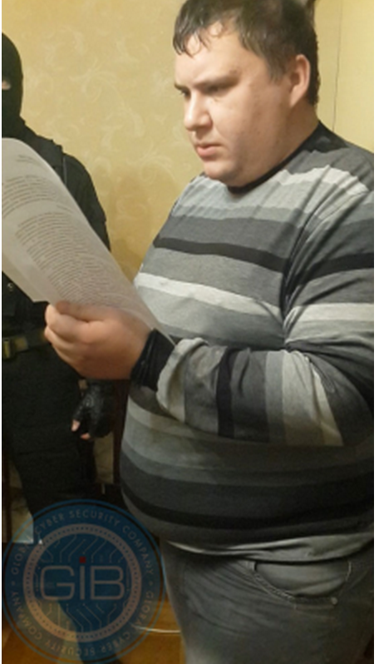
Threat Landscape – Arrest of Paunch
October 4th 2013
Dmitry E. Fedotov has been arrested by the Russian Police.
Article 210 of the criminal code of the Russian Federation was applied: creation and participation in criminal community / criminal organization for joint commission of one or several heavy or especially serious crimes.
Interesting: The Torpig botnet disappeared right after this arrest.
28
Image source: https://krebsonsecurity.com/2013/12/meet-paunch-the-accused-author-of-the-blackhole-exploit-kit/
Notes:
right after the arrest,
the Torpig botnet became unstable and collapsed:
Torpig was an infamous, very sophisticated and successful banking trojan.

Slide 29
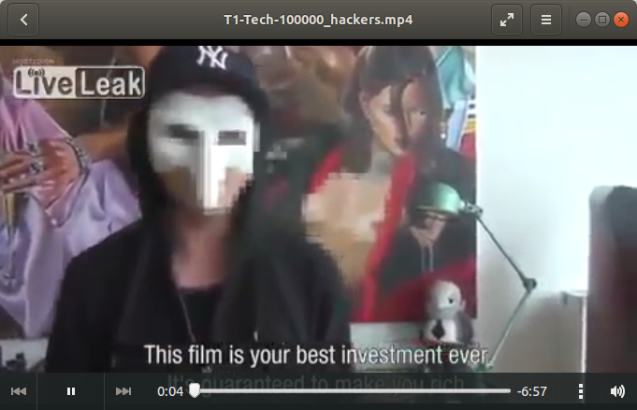
Threat Landscape – Money
Video available at: https://www.youtube.com/watch?v=ocu5N7VIfds. Please check that this is still publicly available before using and embed here.
To unhide slide, click ”slide show” in top navigation bar.
29
Notes:
Being a criminal does not pay off
Play video in the movie folder;
Video duration: 7:00
T1-Tech-100000_hackers.mp4
Possible sources for video: 100.000 euro hack ================== https://www.youtube.com/watch?v=ocu5N7VIfds https://www.youtube.com/watch?v=4JqfChAKSfE https://vimeo.com/76122793 https://www.youtube.com/watch?v=4JqfChAKSfE (sensored)

Slide 30
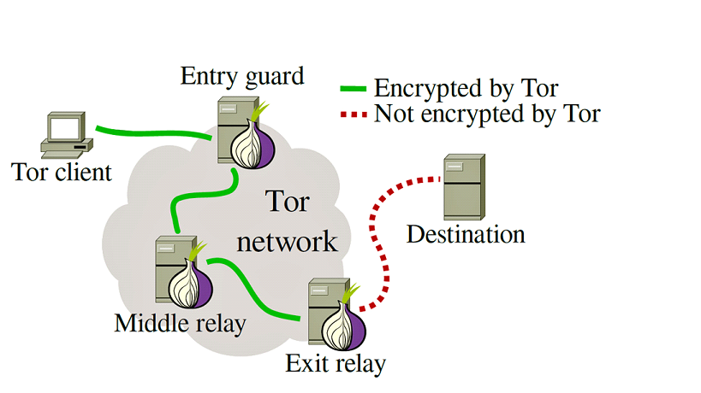
Threat Landscape – Tor
30
Notes:
Explain what TOR is.
Optional video: T1-Tech-Tor.mp4
To be worked out:
What info about the Tor Client is known at the Entry Guard?, does it know about the destination
What info about the client is available at the Exit relay?
Tor client IP gets protected after entering the entry guard
How does the client get to the destination?
Who does a DNS equivalent here?
How do clients and destinations find each other, if they are hidden?

Slide 31
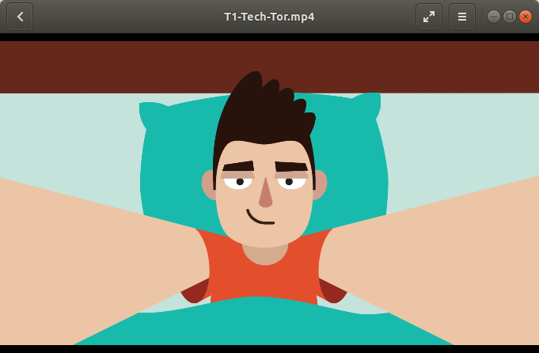
Threat Landscape – Tor
Video available at: https://www.torproject.org/press/video.html.en
Please check that this is still publicly available before using and embed here.
To unhide slide, click ”slide show” in top navigation bar. Delete this note.
31
Notes:
Explain what TOR is.
Optional video: T1-Tech-Tor.mp4
To be worked out:
What info about the Tor Client is known at the Entry Guard?, does it know about the destination
What info about the client is available at the Exit relay?
Tor client IP gets protected after entering the entry guard
How does the client get to the destination?
Who does a DNS equivalent here?
How do clients and destinations find each other, if they are hidden?

Slide 32

Threat Landscape – Tor
Image © 2001-2018 Stephan Uhlmann. Verbatim copying and redistribution permitted.
32

Slide 33
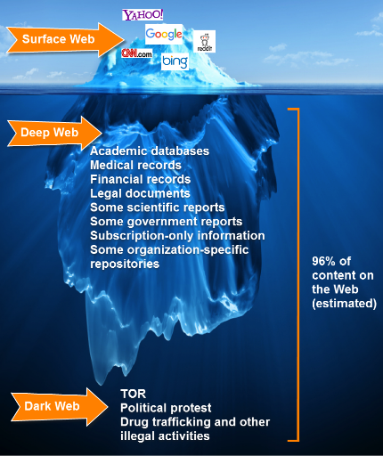

Threat Landscape – Deepweb and Darkweb
https://darkwebnews.com: image Creative Commons Attribution-Noncommerical-Share Alike 3.0 license
33
Notes:
https://darkwebnews.com
Deep Web.
This is a sub-set of the internet that can not be indexed (found) by search engines like Google. This includes all web pages that are behind membership logins, all company and organization web pages used internally and other data. The majority of the deep web does not have anything illegal on it.
Dark Web.
This is a sub-set of the Deep Web that contains all sorts of websites, both legal and illegal. The types of sites include black markets that sell things like drugs, counterfeit goods, and weapons, you also have hacking sites, porn sites, bitcoin tumbling, and even sites for hitmen. The variety of sites on the Dark Web is quite astonishing.

Slide 34
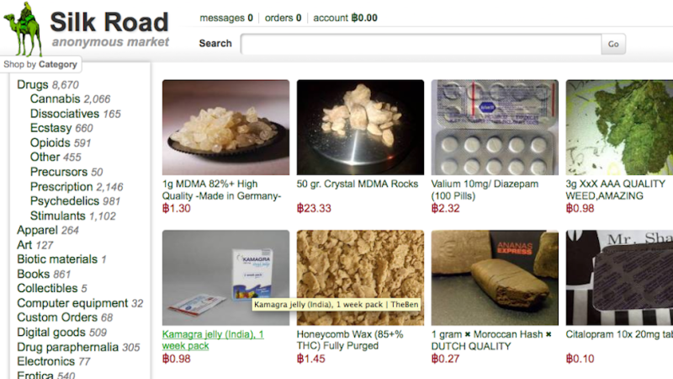
Threat Landscape – Deepweb and Darkweb
34

Slide 35
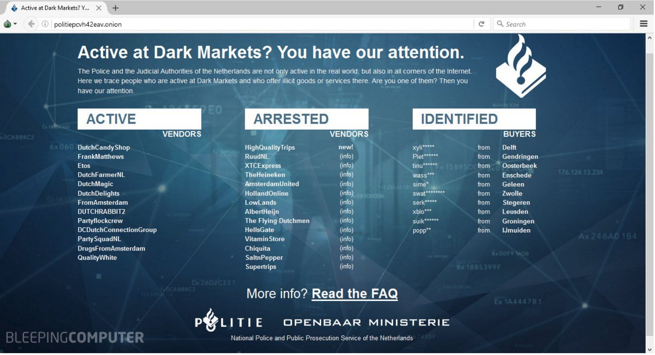
Threat Landscape – Deepweb and Darkweb
35
Dutch police awareness material: https://www.bleepingcomputer.com/news/security/dutch-police-posts-grim-warning-on-seized-dark-web-marketplace/
Notes:
Dutch police awareness material
https://www.bleepingcomputer.com/news/security/dutch-police-posts-grim-warning-on-seized-dark-web-marketplace/
Dutch police took over dark web marketplace, redirected to their own tor address:
http://politiepcvh42eav.onion
(will not resolve in standard browser, tor-browser needed)
Shows active and arrested vendors, + identified buyers

Slide 36
Part II Malware Techniques
Notes:
Goal: Create a common understanding of malware classes and functionality.

Slide 37
Malware Techniques - Terminology
Malware = Malicious Software
Four classes of malware: Potentially Unwanted Programs (PUP) and:
Property | Virus | Trojan | Worm
First seen | 1971 Creeper | 1975 Pervading Animal | 1988 Morris
First named | 1983 | 1200 BC ☺ 1972 | 1975
Distribution | replicates itself by attaching to a host | part of a legitimate program | copies itself cross media
Host | boot/partition sector, program, document | stand-alone | stand-alone
Spreading (typical) | User interaction | User interaction | Exploit
Market Share 2014* | 2.7% | 62.8% | 2.7%
37
Notes:
Keep it simple.
We distinguish between Virus, Trojan, Worms and the rest, called PUP (Potentially Unwanted Programs).

Slide 38
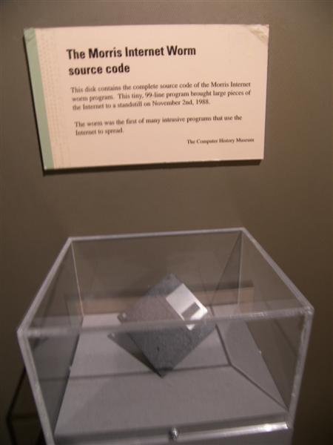
Malware Techniques - Terminology
The First Worm: Morris
1988
Media attention http://www.youtube.com/watch?v=G2i_6j55bS0
Goal of its creator: estimate the size of the Internet
Around 6000 infections
DoS because of an misconception
Establishment of CERT/CC
38
Floppy Diskette containing the source code for the Morris Worm held at the Computer History Museum. CC BY-SA 2.0. Source; Wikipedia
Notes:
The main purpose of this slide is to discuss the establishment of
CERT/CC, which was the world's first CSIRT. According to Wikipedia:
"The Morris worm prompted DARPA to fund the establishment of the CERT/CC
at Carnegie Mellon University, to give experts a central point for
coordinating responses to network emergencies.[9] Gene Spafford also
created the Phage mailing list to coordinate a response to the emergency."
https://en.wikipedia.org/wiki/Morris_worm

Slide 39
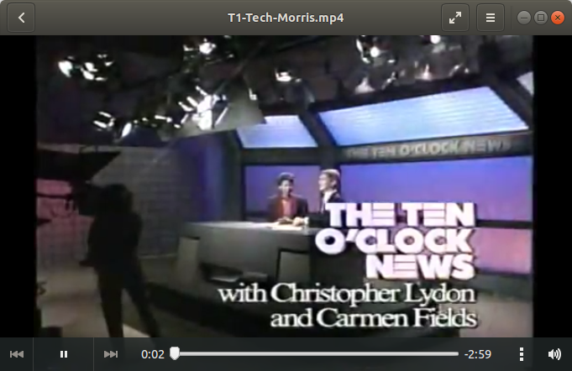
Malware Techniques - Terminology
Video available at: https://limn.it/articles/the-morris-worm-on-television/. Please check that this is still publicly available before using and embed here.
To unhide slide, click ”slide show” in top navigation bar. Delete this note.
39
© 2019 Limn. The content of this website is licensed under a Creative Commons Attribution-NonCommercial-ShareAlike 4.0 International License.
Notes:
T1-Tech-Morris.mp4
Shows the media hype back in 1988 when “Morris” broke out
Video Duration 3:00

Slide 40


Malware Techniques - Terminology
Malware = Malicious Software
Typical functionality:
Backdoor
Bitcoin Miner / Stealer
Click Fraud
DoS
Downloader / Dropper
Ransomware
Remote Access Tool
Scareware
Spam-Engine
Spyware (Banker, Credential Stealer, Keylogger, Sniffer)
40
Notes:
The functionality of malware is very broad.
- Backdoor: bypassing authentication controls, also cryptography (http://rump2007.cr.yp.to/15-shumow.pdf)
- Bitcoin Miner / Stealer: creating/mining or stealing Bitcoins
- Click Fraud: clicking advertisement in an automated fashion
- DoS: performing DoS attacks
- Downloader / Dropper: downloading/installing other malware
- Ransomware: locking and/or encrypting systems and/or data
- Remote Access Tool: allowing remote access to a system
- Scareware: persuading victims to install malware by scaring them
- Spam-Engine: sending spam/phishing emails
- Spyware (Banker, Credential Stealer, Keylogger, Sniffer): stealing of data (personal information, credit card numbers, bitcoin wallet …, certificates, credentials), recoding of keystrokes and screenshots, capturing network traffic.

Slide 41
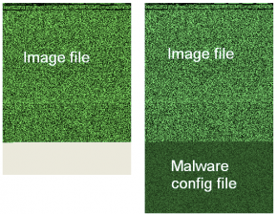
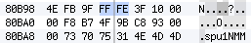
Malware Techniques - Steganography
FF D8 = Start of the picture
FF FE = JPG Comment Indicator
→ configuration
FF D9 = End of the picture
41
Notes:
According to Wikipedia:
Steganography is the practice of concealing a file, message, image, or
video within another file, message, image, or video. The word
steganography combines the Greek words steganos (στεγανός), meaning
"covered, concealed, or protected", and graphein (γράφειν) meaning "writing" and
Steganography includes the concealment of information within computer
files. In digital steganography, electronic communications may include
steganographic coding inside of a transport layer, such as a document
file, image file, program or protocol. Media files are ideal for
steganographic transmission because of their large size. For example, a
sender might start with an innocuous image file and adjust the color of
every hundredth pixel to correspond to a letter in the alphabet. The
change is so subtle that someone who is not specifically looking for it
is unlikely to notice the change.
https://en.wikipedia.org/wiki/Steganography

Slide 42
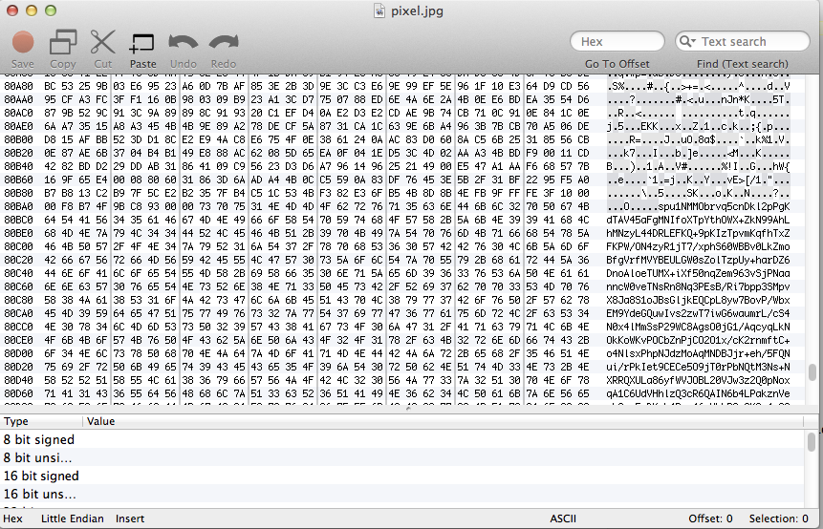
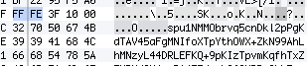
Malware Techniques - Steganography
The configuration can be easily spotted.
42
Notes:
The configuration is encrypted. Decryption is not a problem though, since the source code of Zeus has leaked. Most offsprings use a very similar encryption method – sometimes they just change the chiffre used. In this particular case, the configuration can be decrypted as follows:
1. Extract the comment part of the jpg
2. DeBase64
3. RC4 with the symmetric key extracted from the injected process memory dump
4. VisualDecrypt (basically a XOR)
5. UCL Decompress

Slide 43
Malware Techniques – Network
Bulletproof Hosting
Fastflux
P2P
43

Slide 44
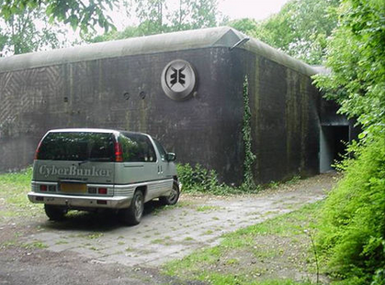
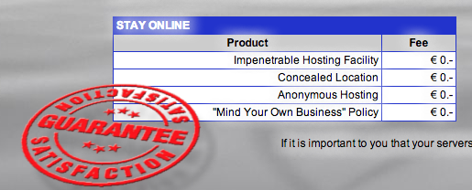
Malware Techniques – Network
Level 1: Bulletproof Hosting
Hosting service provider with a certain hesitation to work with law enforcement and a certain leniency towards the content provided by their customers.
Often, no logs are stored at all.
Prominent example: CyberBunker (NL)
Image source: http://www.cyberbunker.com/web/index.php
44
Notes:
Level 1: Bulletproof Hosting.
Even though ISPs often are regulated to keep log files for some months or even years,
this usually does not hold for hosting service providers – as usual, this depends on the country.
The choice of CyberBunker is made because the blocking of its IP addresses was the trigger for the DRDoS against Spamhaus.
Check which bullet proof hosters exist now:
https://krebsonsecurity.com/2013/10/bulletproof-hoster-santrex-calls-it-quits/

Slide 45
Malware Techniques – Network technics
Level 2: Mess up the takedown process
Problem: A specific server IP or even a IP range can be blocked. Even CyberBunker may be blocked.
Solution: Adopt techniques to make malware activities more resistant to discovery and counter-measures.
Known techniques:
Fast-flux Networks;
Domain Generation Algorithm;
A combination of DGA with Fast-flux;
45
Notes:
Question: “What, if you block malicious IP addresses a/o domain names required by the malware?”
Answer: “The adversaries use Fast-flux networks a/o Domain name Generation Algorithm DGA”
Changing rapidly the IPs is a contributing factor for why IP blocklists are an aging tool, and another reason that DGA domains are so difficult to detect. The combination of DGAs with IP shifting provided by Fast-flux increase the likelihood to be taken down.

Slide 46
Malware Techniques – Fast-flux
Level 2: Fast-flux networks
The basic concept of a Fast Flux network is having multiple IP addresses associated with a domain name, and then constantly changing them in quick succession.
There are two main types of Fast Flux networks:
Single Flux networks;
Double Flux networks;
46
Notes:
FAST FLUX
The constant changing of the domain for the C&C server is also sometimes called “Domain Fluxing” or “Fast Fluxing”, which actually is a reference to an older technique based on abusing the DNS load balancing system. Fast-flux service networks are a network of compromised computer systems with public DNS records that are constantly changing, in some cases every few minutes. These constantly changing architectures make it much more difficult to track down criminal activities and shut down their operations. The basic idea behind Fast-flux is to have numerous IP addresses associated with a single fully qualified domain name, where the IP addresses are swapped in and out with extremely high frequency, through changing DNS records. Two types of flux are known: single-flux and double-flux.
For details of Fastflux: Fast-Flux_Service_Networks.pdf (SupportingMaterials)
For a detailed analisys of Fastflux, check this out:
Exercise: Network Forensics
https://www.enisa.europa.eu/topics/trainings-for-cybersecurity-specialists/online-training-material/technical-operational
PDF file:
https://www.enisa.europa.eu/topics/trainings-for-cybersecurity-specialists/online-training-material/documents/network-forensics-toolset
Section: Task 3: Drive by download without fast flux;
Section: Task 4: Drive by download with fast flux;
Virtual Image: http://www.enisa.europa.eu/ftp/enisa-forensics.ova
pcap files task 3: /data/drive-by-non-fast-flux/drive-by-download_t.pcap
pcap files task 4: /data/drive-by-with-fast-flux/drive-by-download_fast-flux.pcap

Slide 47
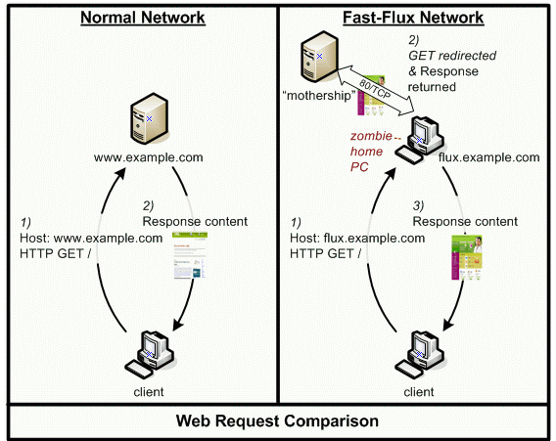
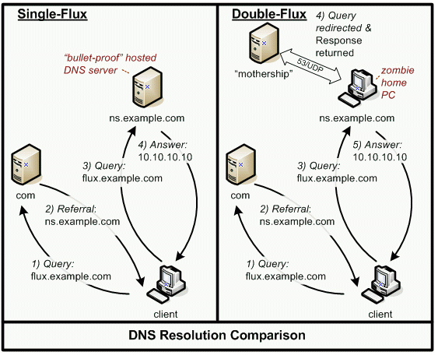
Malware Techniques – Fast-flux
Level 2: single-flux & double-flux
47
Image source: https://www.honeynet.org/book/export/html/130. Authors William Salusky and Robert Danford, 13 July 2007
Notes:
The Figure on the left, shows a single-flux network. A normal web browser communicating directly with a typical website, next the case of a single-flux service network, where the end user’s browser communication is proxied via a redirector (the ¨flux-bot¨ or ¨flux-agent¨). When a victim believes that they are browsing http://flux.example.com, their browser is actually communicating with the fast-flux service network redirector which redirects the requests to the target website. Single-flux service networks change the DNS records for their front end node IP address as often as every 3-10 minutes, so even if one flux-agent redirector node is shut down, many other infected redirector hosts are standing by and available to quickly take its place. We have found these fast-flux networks to be composed of primarily compromised home computers.
The Figure on the right, shows double-flux, a more complex technique providing an additional layer of redundancy. Specifically, both the DNS A record sets and the authoritative NS records for a malicious domain are continually changed in a round robin manner and advertised into the fast-flux service network. DNS and HTTP services are both served from the same upstream mothership node.
On the left side a single-flux lookup: the client wants to resolve the address http://flux.example.com/. Normal DNS queries occours, but for a normal DNS lookup, the answer IP address usually remains constant over a certain period of time, whereas for single-flux nodes, the answer changes frequently. On the right hand side, again, the client wants to look up the address flux.example.com. In a third step, the client queries ns.example.com for the address flux.example.com, however, this authoritative nameserver is actually part of the double-flux scheme itself and its own IP address changes frequently. When a DNS request for flux.example.com is received from the client, the current authoritative nameserver forwards the queries to the mothership node for the required information. The client can them attempt to initiate direct communication with the target system (although this target system will itself be a dynamically changing front end flux-agent node).

Slide 48
Malware Techniques – DGA
Level 2: Domain Generation Algorithm
“Algorithms seen in various families of malware that are used to periodically generate a large number of domain names that can be used as rendezvous points with their command and control servers” Wikipedia.
Thousands of DGA-based domains generated, but only few valid domain provides the C&C service.
In 2008, Kraken was the first malware family to use a DGA, later Conficker made DGA a lot more famous.
48
Notes:
DGA
A Domain Generating Algorithm (DGA) is a program or routine that provides malware with new domains on demand or on the fly, in order to prevent C&C servers from being blacklisted or taken down.
The DGA produces random looking domain names. The idea is that two machines using the same algorithm will contact the same domain at a given time, so they will be able to exchange information or fetch instructions.
For details of DGA: DGA_DomainGenerationAlgorithm.pdf (SupportingMaterials)

Slide 49
Malware Techniques – DGA example
Level 2: Domain Generation Algorithm
Dyre’s DGA for the date July 4, 2015 and the input number 16. This is only one of 333 possible domains generate each day by the algorithm. A Python implementation for generating Dyre’s DGA for a single day.
Image Source: https://blogs.cisco.com/security/talos/threat-spotlight-dyre. Authors Alex Chiu & Angel Villegas.
49
Notes:
This malware contains a dga_create_domain routine referenced from one place and inside a small loop. The routine is called with a UNICODE string and integer argument. The string - the system time - is obtained and formatted as “year-month-day” string and the integer number is hardcoded in the range [0, 333].
https://blogs.cisco.com/security/talos/threat-spotlight-dyre

Slide 50
Malware Techniques – Network
Level 3: P2P
Problem: Motherships can be detected and blocked. The same holds for the C&C servers of centralized botnets of course.
Solution: P2P
50
Notes:
Level 3: Motherships. Motherships are hidden behind a Fastflux layer,
however, they can be block, taken down or taken over.
The adversaries may to the next Level: P2P,
which has no central element at all.
Note that commands easily can be authenticated by asymmetric encryption e.g. signing with a private key.

Slide 51
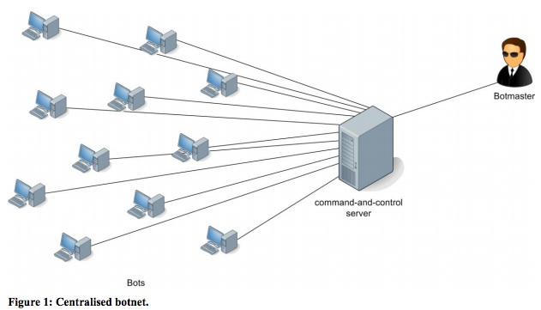
Malware Techniques – Network
Level 3: P2P
simple infrastructure hierarchical requires a central server
51
© European Network and Information Security Agency (ENISA), 2011.Reproduction is authorised provided the source is acknowledged.
Notes:
Simple botnet, can be easily taken down, by taking out the cnc.
Single point that supplies configurations to the bots, if the bot does not get new instructions, its unusable here.
Help out is: p2p .. next slide
https://www.enisa.europa.eu/topics/csirts-in-europe/glossary/botnets
https://www.enisa.europa.eu/publications/botnets-measurement-detection-disinfection-and-defence

Slide 52
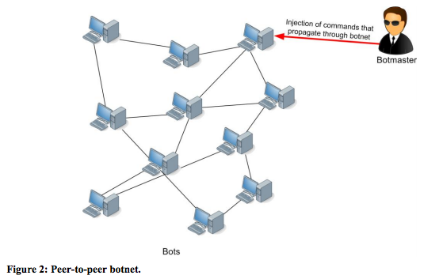
Malware Techniques – Network
Level 3: P2P
P2P infrastructure is hard to mitigate
52
© European Network and Information Security Agency (ENISA), 2011.Reproduction is authorised provided the source is acknowledged.
Notes:
Distributing the configurations in a p2p network the botnet removed its single point of failure (CnC)
Each bot can act as a CnC.
https://www.enisa.europa.eu/topics/csirts-in-europe/glossary/botnets
https://www.enisa.europa.eu/publications/botnets-measurement-detection-disinfection-and-defence

Slide 53
Malware Techniques – Host
Persistence
Rootkits
Reverse Engineering (RE) and Anti-RE
Packing
Anti-Disassembler
Anti-Debugger
Anti-Virtual Machine
Obfuscation
53
Notes:
The adversary needs a mechanism to avoid AV engines and to establish persistence on an infected host.

Slide 54
Malware Techniques – Host
Persistence
the continued or prolonged existence of something. here: malware should survive a system reboot.
Typically:
Windows: Registry, … Tool: Autoruns
*nix: rc.d, … Tool: LKM
Mac OS X: [launchd].plist, … Tool: Knock Knock
Persistence is needed, thus, it is an excellent way to detect malware.
54
Notes:
Persistence is crucial.
There are tools allowing detecting several mechanisms, for example Autoruns (Windows), Linux Kernel Module (LKM, *nix) and KnockKnock (Mac OS X).

Slide 55
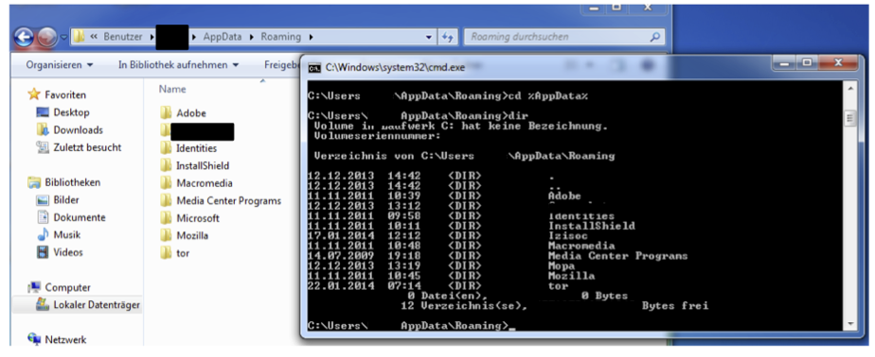
Malware Techniques – Host
Rootkits
Manipulate of the output of system function calls.
Not simple to do: Inconsistencies may be visible:
Image source unknown
55
Notes:
User mode rootkits: The implementation of a user mode rootkit (ring3 rootkit) in a Zeus offspring known as Zeus 64bit/tor, is very buggy.
The rootkit tries to hide the folders used by the malware. (replaces ps command)
Using Windows Explorer, the malware folders (Izissec and Mopa) are not visible.
However, using the command line, Izisec and Mopa are visible, but the folder Microsoft is not – off-by-one-bug?
Mention the story about the Sony Rootkit
https://en.wikipedia.org/wiki/Sony_BMG_copy_protection_rootkit_scandal

Slide 56
Malware Techniques – Host
Rootkits
Manipulation of MBR Bootkit
Prior to OS start
Can be used to load a malicious driver
Master Boot Record (MBR)
Sector 0
Hidden Sectors
Sector 1-59
Hidden Sectors
Sector 60-61
Hidden Sector
Sector 62
OS partitions
Slackspace
Malicious Master Boot Record (MBR)
Sector 0
Hidden Sectors
Sectors 1-59
Hidden Sectors
Sector 60-61
Original MBR
Sector 62
OS partitions
Slackspace
Malicious Driver
56
Notes:
Boot mode rootkits: Torpig, a notorious banking trojan, made use of a bootkit known as Mebroot.
This incredibly sophisticated piece of software modified the hard disk layout as follows:
1. Backup the MBR sector 0 to the hidden sector 62.
2. Place the code of a malicious Microsoft Windows driver in the slackspace of the hard disk.
3. Replace the MBR sector 0 with custom code that jumps to hidden sector 60 (and 61).
4. Hidden sector 60 contains code that then starts Windows (XP) and loads as the first step the malicious driver from the slackspace.

Slide 57
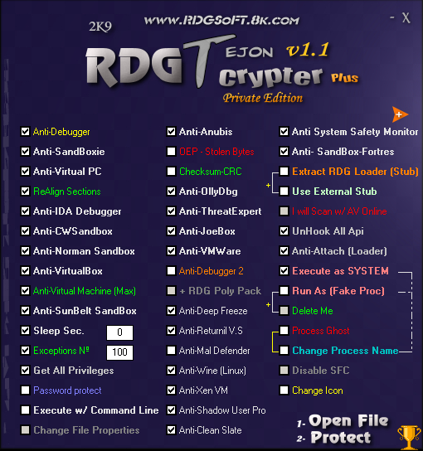
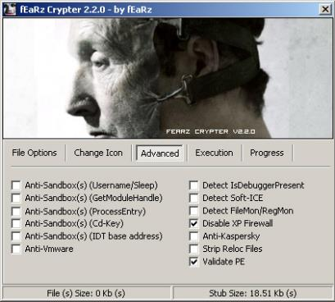
Malware Techniques – Host
Reverse Engineering (RE) and Anti-RE
AV detection: 0 / 54
Image source: https://www.esetnod32.ru/company/viruslab/analytics/doc/Stuxnet_Under_the_Microscope.pdf
57
Notes:
Reverse Engineering (RE) and Anti-RE.
It is out of scope to go into Anti-Reverse Engineering methods.
The goal of Anti-RE, in the end, is to bypass AV engines.
Goal anti RE is to obfuscate code to make the lives of reverse engineers harder.

Slide 58
Malware Techniques – Host
Reverse Engineering (RE) and Anti-RE
Packing is complicated. It includes many different Anti-RE techniques, for example
Detection of a virtual machine
Detection of a debugger
Code obfuscation
…
Code obfuscation transforms code into a form that is difficult for humans to understand.
58
Notes:
With regards to obfuscation though,
a simple demonstration can be given: de-obfuscate a malicious javascript.
- 2012, Qualys: 90% of all malware samples employ at least one Anti-RE technique, of which 80% detects VM.
- 2014 Symantec: Only 18% of all malware samples detects VM. VM nowadays are not only used by malware researchers anymore.
It is not clear if it is legal to reverse engineer software in US or not: "The reverse engineering of software in the US is generally a breach of contract as most EULAs specifically prohibit it, and courts have found such contractual prohibitions to override the copyright law which expressly permits it; see Bowers v. Baystate Technologies [29][30]". In the US, Reverse Engineering is sometimes a legal problem.

Slide 59
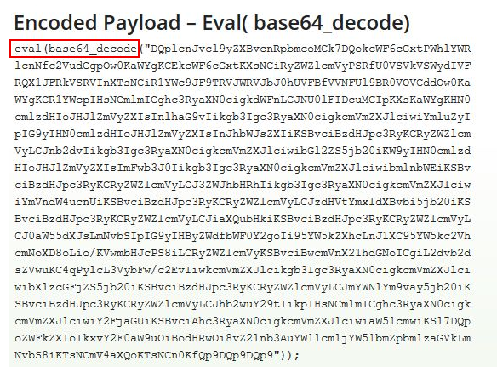
Malware Techniques – Code obfuscation
Code obfuscation converts the source code into obfuscated and completely unreadable form.
Image Source: https://secure.wphackedhelp.com/blog/eval-base64-decode-hack-wordpress/
59
Notes:
Code obfuscation is for example used in by malicious Wordpress (PHP) themes and plugins.
The code is obfuscated and not readable by a human can contain for example a backdoor.
Image Source: https://secure.wphackedhelp.com/blog/eval-base64-decode-hack-wordpress/

Slide 60
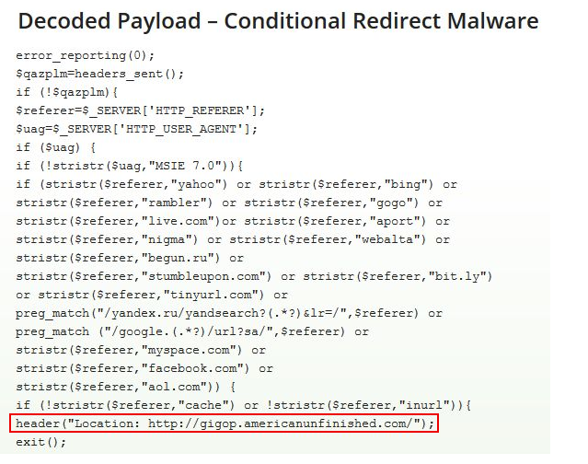
Malware Techniques – Code obfuscation
Decode
CyberChef (https://github.com/gchq/CyberChef)
Image Source: https://secure.wphackedhelp.com/blog/eval-base64-decode-hack-wordpress/
60
Notes:
Code obfuscation is for example used in by malicious Wordpress (PHP) themes and plugins.
The code is obfuscated and not readable by a human can contain for example a backdoor.
Source: https://secure.wphackedhelp.com/blog/eval-base64-decode-hack-wordpress/

Slide 61
Part III Hacking Tools and Techniques
Notes:
“This section is about hacking tools and techniques, please bare in mind this is not an hacking class nor a malware reverse engineering class.
We will introduce you with tools and techniques criminal usually use, from a technical point of view. “

Slide 62
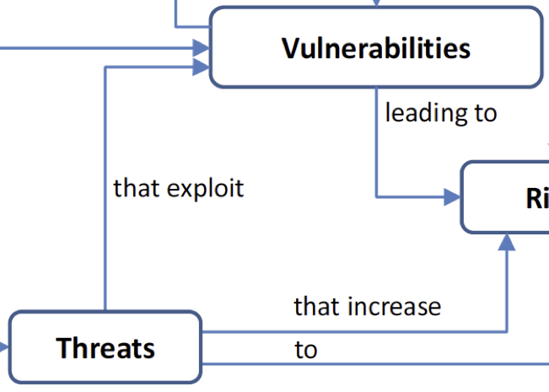
Hacking – Vulnerabilities
Vulnerabilities: a weakness that can be exploited
ie. Allows for hacking
ie. Allows for violation of a reasonable security policy.
There is no such thing as 100% safe software.
62
Notes:
There is one notion that has to be made clear:
the difference between a weakness and vulnerability.
A weakness is a bug, a “feature”,
a misconception that becomes a vulnerability if it can be abused/exploited
to violate a (reasonable) security policy / to violate AIC.

Slide 63
Hacking – Example 1: [DR]DoS
71783 (1) – NTP monlist Command Enabled
Synopsis
The remote network time service could be used for network reconnaissance or abused in a distributed denial of service attack.
Description
The version of ntpd on the remote host has the 'monlist' command enabled. This command returns a list of recent hosts that have connected to the service. As such, it can be used for network reconnaissance or, along with a spoofed source IP, a distributed denial of service attack.
Solution
If using NTP from the Network Time Protocol Project, either upgrade to
NTP 4.2.7-p26 or later, or add 'disable monitor' to the 'ntp.conf'
configuration file and restart the service. Otherwise, contact the
Vendor. Otherwise, limit access to the affected service to trusted hosts.
63
Notes:
Gain the understanding that the possibility to abuse/misuse a feature, such as the NTP monlist command, is a vulnerability.
The notion of [DR]DoS has been introduced in the beginning of this module.
Here, a specific example is looked at: the NTP monlist command. It can be abused in two ways:
- (partial) enumeration of an internal network. Note that reconnaissance is the first step of an [targeted] attack.
Because it is a UDP protocol and there is a (huge) amplification factor, this command is great to perform a distributed reflected denial of service attack.
Here, we look at a description of a Nessus module.
The solution consists of two parts,
both have been covered already (so it is good to have a repetition) in Part I: [DR]DoS.

Slide 64
Hacking – Example 1: [DR]DoS
71783 (1) – NTP monlist Command Enabled
Synopsis
The remote network time service could be used for network reconnaissance or abused in a distributed denial of service attack.
Risk factor
Medium
CVSS Base Score
5.0 (CVSS2#AV:N/AC:L/Au:N/C:N/I:N/A:P)
References
CVE-2013-5211, CWE-20, cpe://a:ntp:ntp:4.2.7
64

Slide 65
Hacking – Example 1: [DR]DoS
cpe://a:ntp:ntp:4.2.7
CPE: Common Platform Enumeration
standard to describe and identify classes of applications, operating systems and hardware
CWE: Common Weakness Enumeration
unified, measurable set of software weaknesses
CVE: Common Vulnerability and Exposure
dictionary of common names for public known information security vulnerabilities
CVSS: Common Vulnerability Scoring System
system to score/weight vulnerabilities between 0 and 10.0.
CWE-20: Improper Input Validation
CVE-2013-5211
CVSS 5.0 (Medium)
65
Notes:
Gain understanding of the mnemonics CPE, CWE, CVE and CVSS.
1. CPE: NTP version <=4.2.7 is vulnerable
2. CWE: The weakness is CWE-20: Input Validation. Why? The request is forged in such a way that the response will be sent to another IP address as the requestor’s.
3. CVE: CVE-2013-5211: Because there is a weakness that can be exploited, it has been classified as vulnerability. In year 2013, it was assigned the number 5211.
4. CVSS: A CVSS 5.0, which consists of several metrics, is considered as “Medium” (risk factor).

Slide 66
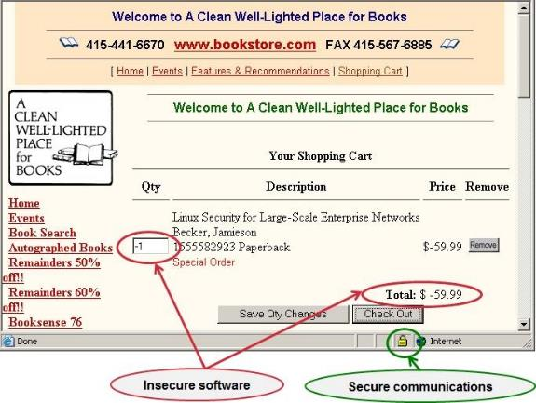
Hacking – Example 2: Improper Input Validation
CWE-20: Improper Input Validation
Image Source: https://twitter.com/ericbaize/status/492777221225213952
66
Notes:
Since the NTP monlist vulnerability bases on the weakness CWE-20,
we use it here for further illustration of a weakness.
Also, the illustration is quite funny (Source: unknown).
This picture shows a weakness that is exploitable (=vulnerability) as clear as possible.
The input field “Qty” is not properly checked: even if it checks for integers, a negative integer is invalid in the context the value is used – namely as a quantity. This is the weakness.
As a consequence, the price gets negative: the weakness thus is exploitable: integrity is violated.
It could go even so far as to credit the price to the hacker’s credit card. Now, this would be a nasty vulnerability.

Slide 67
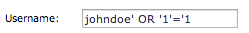
Hacking – Example 3: SQL Injection
CWE-89: SQL Injection
How does it work? Database-powered applications often use user-supplied values to create a database queries:
$q = sql_query(“SELECT * FROM users WHERE user=‘$user‘“);
User-supplied value $user:
$q = sql_query(“SELECT * FROM users WHERE user=‘johndoe‘ OR ‘1‘=‘1‘“);
Result: full dump of the table users
67
Notes:
Gain an understanding of a SQL injection vulnerability.
In the previous example, a SQL injection vulnerability has been exploited.
But how does it work? First, the technical details, then a demonstration.

Slide 68

Hacking – SQL Injection
Demonstration: Access to an Online Banking System
68

Slide 69
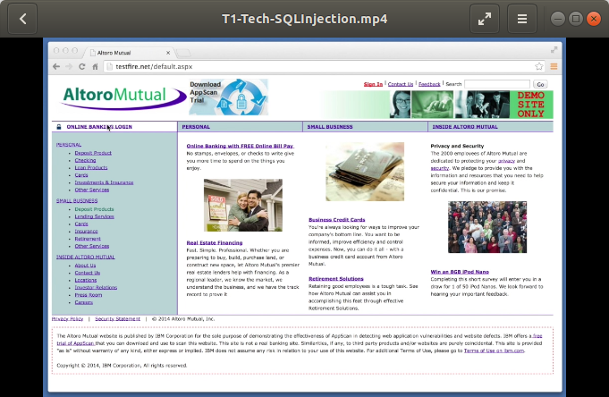
Hacking – SQL Injection
Video available on request from TRANSITS or use site http://testfire.net/ . Please check that this is still publicly available before using and embed here.
To unhide slide, click ”slide show” in top navigation bar. Delete this note.
69
Notes:
Play the video in the movie folder, students homeworks http://testfire.net/
Video duration: 1:35
0:00 The AltoroMutual bank provides online banking services.
Access is granted by single factor authentication: Username and Password.
0:06 We have no further information.
Let us start with an arbitrary name “Hans” and Password “Blup”.
0:13 Of course, the login attempt failed.
We now that a ‘ is a character which should be escaped.
Let us try appending it at the Password and seeing what happens.
0:25 We get a very useful error message:
we see the resulting SQL query.
With this web application there are two problems:
Escape characters such as ‘,
2. On production system do not show debugging information.
0:36 Let us try again – this time we are going to construct a correct SQL query.
The username is “Hans” again, but the password will be chosen as we learned.
The resulting SQL query will be:
username = 'Hans' AND password = 'Blup' OR '1'='1'
We copy paste the password from the username field and …Login
1:05 We are in. There are surprises here:
1. We did log in with a username that is not in the system.
2. We are the user “Admin”.
This is due to the fact that it is not entirely clear
what the web application is doing with results from the SQL query.
1:15 As “Admin” we have access to certain functions,
such as list the users and change their passwords.
1:33 We sign off and login as “CClay” …

Slide 70
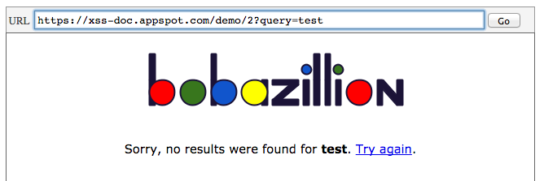
Hacking – Example 4: Cross Site Scripting
CWE-79: Improper Neutralization of Input During Web Page Generation ('Cross-site Scripting')
How does it work? Web applications often use user-supplied values for the server’s response, which usually is a HTML web site:
Source: https://xss-doc.appspot.com/demo/2
70
Notes:
Gain an understanding of a Cross Site Scripting vulnerability.
The user-supplied value in this case is test.
The result page shows the user-supplied value as it
has been provided by the user, so to say as a reflection.

Slide 71
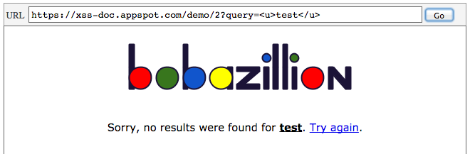
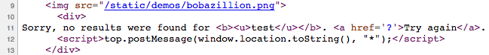
Hacking – Example 4: Cross Site Scripting
CWE-79: Improper Neutralization of Input During Web Page Generation ('Cross-site Scripting')
How does it work? A malformed user-supplied value allows to abuse this weakness. A innocent example, purely HTML::
Source: Google
Source: https://xss-doc.appspot.com/demo/2
71
Notes:
Exploiting this vulnerability thus is called “Reflected XSS Attack”.
0. The user-supplied value <u>test</u> is pure HTML and
tells the browser to render test underlined.
The HTML source code of the page clearly shows that the user-supplied
value is directly added in the server’s response (HTML web site): test is underlined.

Slide 72
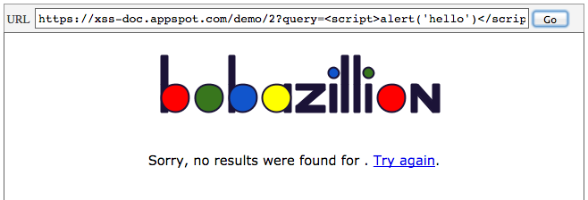
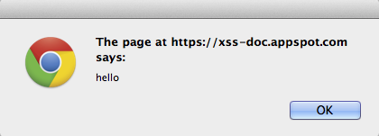
Hacking – Example 4: Cross Site Scripting
CWE-79: Improper Neutralization of Input During Web Page Generation ('Cross-site Scripting')
How does it work? A malformed user-supplied value allows to abuse this weakness. An example using JavaScript:
Source: Google
Source: https://xss-doc.appspot.com/demo/2
72
Notes:
Exploiting this vulnerability thus is called “Reflected XSS Attack”.
0. The user-provided value <script>alert('hello')</script> will
execute javascript in the context of the user’s browser:
an alert-box with text ‘hello’ will appear.
The HTML source code of the page clearly shows
that the user-supplied value is directly added in
the server’s response (HTML web site): javascript is executed.
Being able to inject javascript code allows the attacker to do
almost anything, e.g. stealing cookies to overtake sessions,
stealing credentials and dos’ing arbitrary targets.
“There are also Stored XSS attack which are even worst because the malicious payload gets stored and provided to any user visit the website”

Slide 73
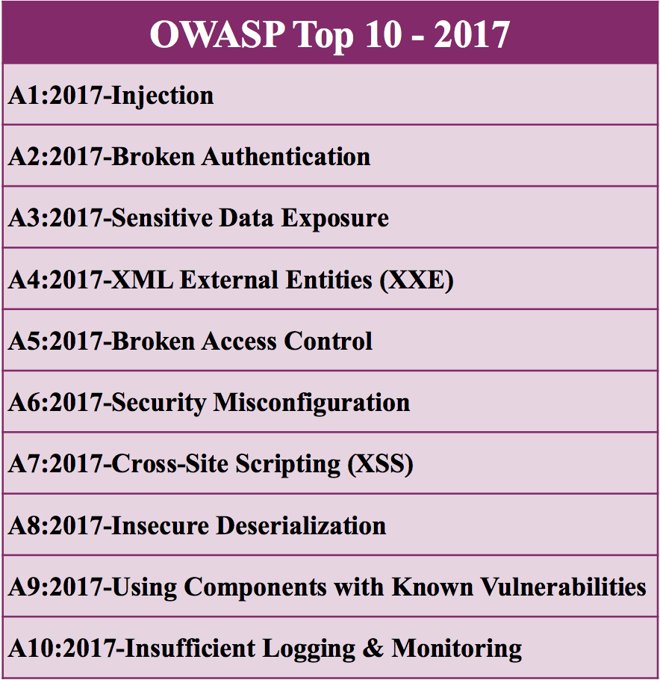
Hacking – OWASP Top Ten Weakneses
Source: https://www.owasp.org/images/7/72/OWASP_Top_10-2017_%28en%29.pdf.pdf
73
Notes:
Image credit:
https://3.bp.blogspot.com/-e3gIv5o6VlY/WhMM8ggNXPI/AAAAAAAABR8/CRMPQ6sBDU4gSEVrTeKaQSD091qnztOJQCLcBGAs/s1600/OWASP-Top-10.png
OWASP is an organization dedicated to web application security.
In the Top Ten, Injections, in particular SQL Injections, are A1 and Cross Site Scriptings are A7.
https://www.owasp.org/images/7/72/OWASP_Top_10-2017_%28en%29.pdf.pdf

Slide 74
Hacking – Injecti0n-Proxy
Demonstration: Trojanization of a download on-the-air
74
Notes:
This video shows how easy it is nowadays to fully compromise a system.

Slide 75
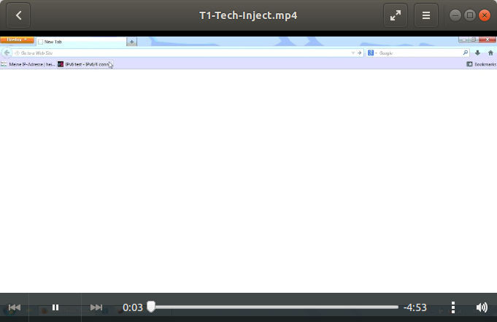
Hacking – Injecti0n-Proxy
Video available on request from TRANSITS. Please check that this is still publicly available before using and embed here.
To unhide slide, click ”slide show” in top navigation bar. Delete this note.
75
Notes:
Play video in the movie folder.
T1-Tech-Inject.mp4
Video duration: 4:45
In the video, a benign download is trojanized on-the-air:
after executing the downloaded program, a reverse shell to the attacker’s server is opened.
A few commands later, the attacker has a fully fledged vnc connection.
Files, of course, can be downloaded as well.
The technique used is simple:
The victim’s wireless adapter usually automatically connects to its Preferred Wireless Network.
Having the right equipment (Pinapple WiFi) though,
the attacker actually poses as the Preferred Wireless Network.
Since the traffic now can be controlled by the attacker (MITM),
trojanizing a download on-the-air is only a matter of the right tools.
0:00 We are looking at the victim’s PC running Windows 7.
The victim decides to download Sysinternals’ ProcessExplorer (from the correct server) because he just read about it how great it is.
The victim extracts the archive and starts ProcExp.exe.
0:54 Let us switch to the attacker’s PC.
The attacker just was informed that the victim’s PC got infected.
Using metasploit → exploit he starts a meterpreter session on the victim’s PC.
Attacker’s PC: 130.59.95.199 listening on port 4444
Victim’s PC: 172.16.42.210 with source port 49223
1:00 Using meterpreter → sysinfo he gets information about the victim’s PC.
Using meterpreter → getuid he gets information about the current user.
1:13 Using meterpreter → getsystem he would like to leverage to SYSTEM, which fails.
Actually, there is not need for that but getting root is nice always ☺
1:21 He needs to disable UAC by exploit.
We omit the technical details, however, it is nice to see that the exploit has to be run twice.
The first attempt failed. This is quite common –
good exploits work (almost) all the time,
non-reliable exploits works sometimes 1 out of 100 tries only.
2:08 He now is ready to install and run vnc on the victim’s PC
without him noticing: Using meterpreter → run vnc allows him to do just that.
This will take a while…

Slide 76
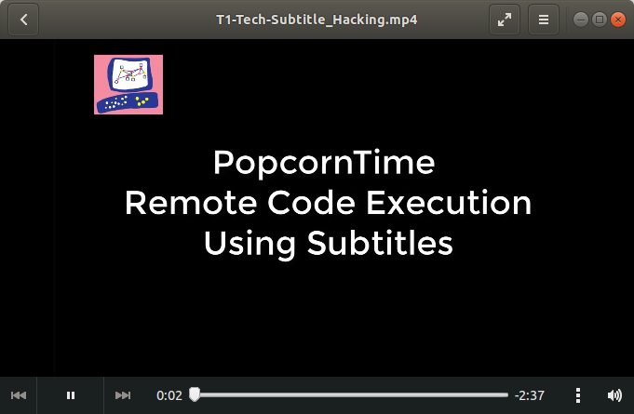
Hacking – Metasploit
Video available at: https://thenextweb.com/security/2017/05/24/attack-subtitles-media-player-exploit/ . Please check that this is still publicly available before using and embed here.
To unhide slide, click ”slide show” in top navigation bar. Delete this note.
76
Notes:
Play video in the movie folder.
T1-Tech-Subtitle_Hacking.mp4
Video duration: 2:38

Slide 77
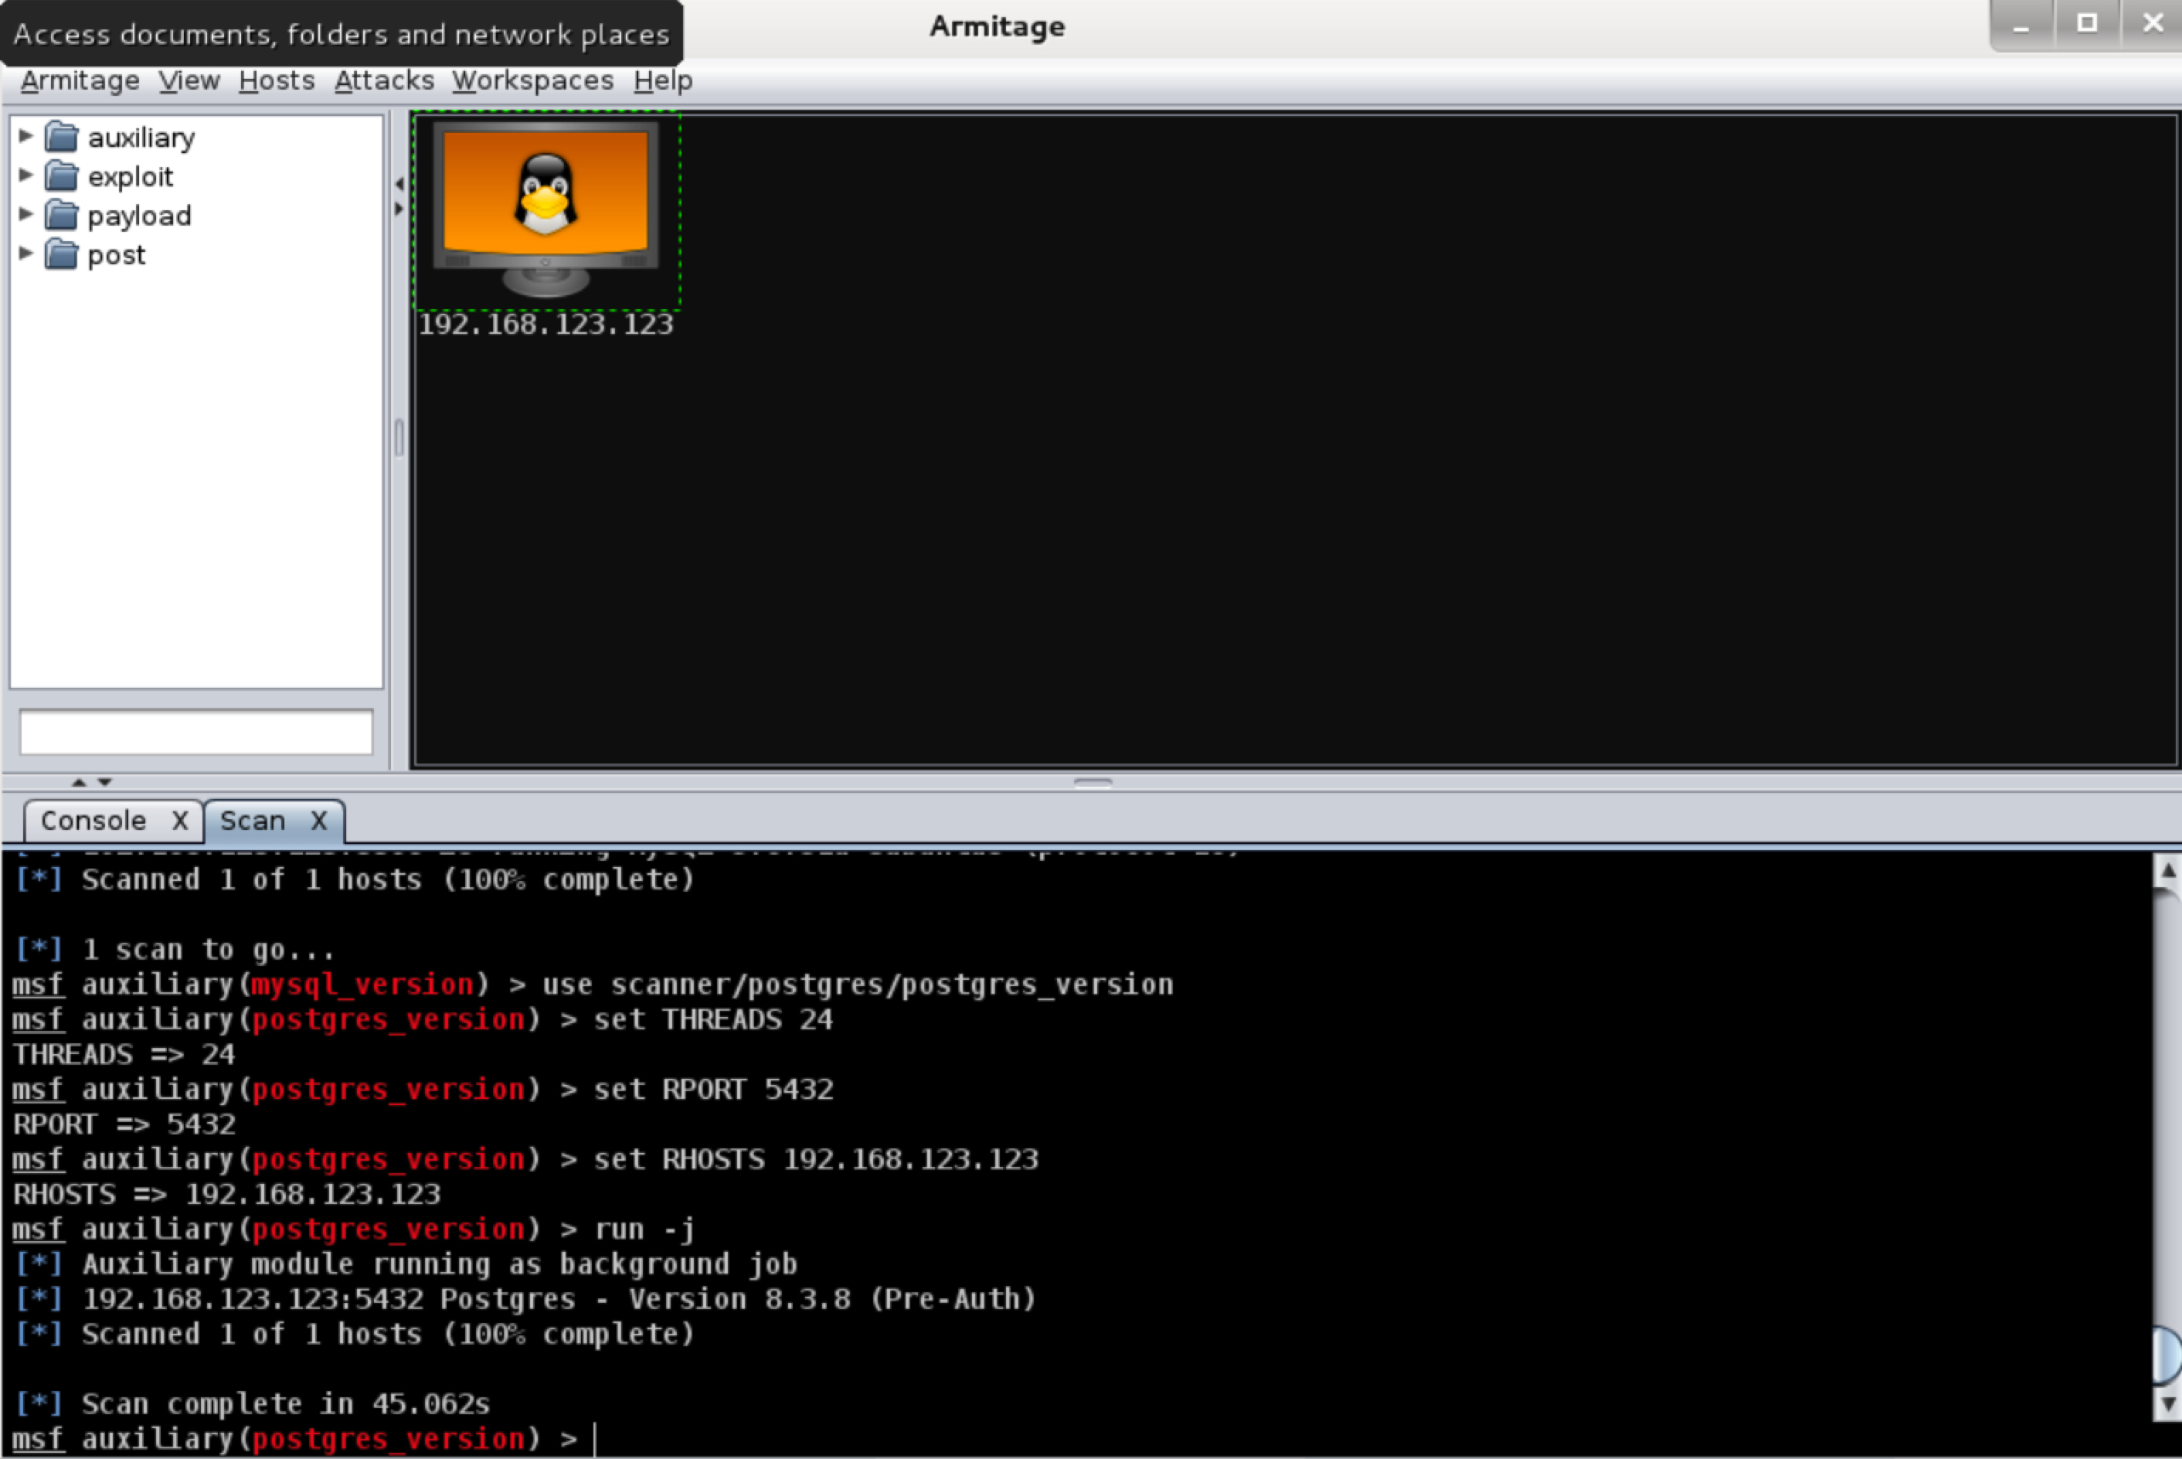
Hacking – Hacking a system – step 1
77
Slides from: https://github.com/radicallyopensecurity/Digitally-Aware. License Creative Commons Attribution 4.0 International (CC BY 4.0)
Notes:
*** Give a 5 (max 10) minute live demo of compromising a system. If the demo is not possible, use the coming slides instead. ***
In the and next several slides, we show the tool Armitage, a scriptable red team collaboration tool for Metasploit that visualizes targets, recommends exploits, and exposes the advanced post-exploitation features in the framework just in order to show how easy could be to attack.
The coming slides are taken from
Slides from: https://github.com/radicallyopensecurity/Digitally-Aware. License Creative Commons Attribution 4.0 International (CC BY 4.0)

Slide 78

Hacking – Hacking a system – step 2
78
Slides from: https://github.com/radicallyopensecurity/Digitally-Aware. License Creative Commons Attribution 4.0 International (CC BY 4.0)

Slide 79

Hacking – Hacking a system – step 3
79
Slides from: https://github.com/radicallyopensecurity/Digitally-Aware. License Creative Commons Attribution 4.0 International (CC BY 4.0)

Slide 80

Hacking – Hacking a system – step 4
80
Slides from: https://github.com/radicallyopensecurity/Digitally-Aware. License Creative Commons Attribution 4.0 International (CC BY 4.0)

Slide 81

Hacking – Hacking a system – step 5
81
Slides from: https://github.com/radicallyopensecurity/Digitally-Aware. License Creative Commons Attribution 4.0 International (CC BY 4.0)

Slide 82

Hacking – Hacking a system – step 6
82
Slides from: https://github.com/radicallyopensecurity/Digitally-Aware. License Creative Commons Attribution 4.0 International (CC BY 4.0)

Slide 83

Hacking – Hacking a system – Total Control
83
Slides from: https://github.com/radicallyopensecurity/Digitally-Aware. License Creative Commons Attribution 4.0 International (CC BY 4.0)

Slide 84

Hacking – Google Hacking
In 2002, Johnny Long began to collect Google Searches (“dorks”) that uncover vulnerable systems and/or sensitive information disclosures.
Can rapidly uncover lists of email addresses, login credentials, sensitive files, website vulnerabilities, and even financial information (e.g. payment card data)
This large dictionary of queries, grew into the Google Hacking Database (GHDB)
Image source: https://www.offensive-security.com/community-projects/google-hacking-database/
84
Notes:
Image source: https://www.offensive-security.com/community-projects/google-hacking-database/

Slide 85
Part IV Defense and Mitigation
Notes:
Common understanding of the terms Incident Response and Data Forensics.
There is no need to define the term Incident. Common knowledge is just fine.

Slide 86
Defense and Mitigation
Prevent
Detect
Response
86

Slide 87

Defense and Mitigation – Incident Prevention
- Be a good neighbor:
1. avoid dos amplifiers in your network
2. avoid hosting bots, keep your infra patched
- Be prepared for the worse case, ex: Ransom-ware attacks
1. Have Backups
2. If you have to have ancient OS running, isolate them from the network
- When running an infrastructure have a Vulnerability Handling Process
Image source: http://csirt.egi.eu/activities/. © EGI CSIRT
87
Notes:
The Open Resolver Project can inform you of any DoS amplifiers in your
network
Third parties like Shadowserver and Microsoft can also inform you if you
have any bots in your network
http://csirt.egi.eu/activities/

Slide 88

Defense and Mitigation – Vulnerability Management
Vulnerability management is SUPER critical to Operational Security – and multi-faceted
Catalog hardware: company assets, BYOD, “unofficial” stuff
Catalog software: operating systems, virtualization platforms, and SW versions
Catalog services: both internal and external (“cloud-based”)
Manage deployment of patches
Verify patch installation
Sanctions for unpatched things
Image source: https://www.tenable.com/sc-dashboards/application-patch-rate
88
Notes:
Images from: https://www.tenable.com/sc-dashboards/application-patch-rate

Slide 89

Defense and Mitigation – What about The Cloud
Video available at:https://www.youtube.com/watch?v=CFdZWgiAj8I. Please check that this is still publicly available before using and embed here.
To unhide slide, click ”slide show” in top navigation bar. Delete this note.
89
Notes:
T1-Tech-The Cloud Kitty Flanagan.mp4
Optional: funny video about “The Cloud”
Video Duration 5:06

Slide 90

Defense and Mitigation – MISP
MISP is a open-source threat intelligence platform for sharing, storing and correlating Indicators of Compromise
Facilitates both human (ticket-based) and machine-based (STIX, OpenIOC) sharing
Helps to correlate between attributes and indicators from malware, campaigns, and analysis
Generates Snort/Suricata IDS rules
Image source: https://www.misp-project.org/assets/images/banner.jpg
90
Notes:
Images from: https://www.misp-project.org/assets/images/banner.jpg

Slide 91

Defense and Mitigation – Virus Total
VirusTotal is an online (cloud) service that analyzes suspicious files and facilitates real-time detection of viruses, worms, trojans and malware
VirusTotal aggregates over 70 antivirus and online scanning engines
This is one of many similar platforms: MalwareBytes, Malwr.com (offline)
Be careful of uploading personal or confidential information to Virus Total, and similar websites
Image source: https://www.ghacks.net/2016/02/01/virustotal-scan-firmware-for-signs-of-manipulation/
91
Notes:
Images from: https://www.ghacks.net/2016/02/01/virustotal-scan-firmware-for-signs-of-manipulation/

Slide 92

Defense and Mitigation – No More Ransom
An initiative to help victims of ransomware retrieve their encrypted data without having to pay the criminals
100+ partners from the public and private sector. 50+ decryption tools covering 100+ families of ransomware. So far, these tools have managed to decrypt more than 30,000 devices
The project also educates users about ransomware and preventative countermeasures
Screehshot: https://www.nomoreransom.org/crypto-sheriff.php?lang=en
92
Notes:
Screenshot from: https://www.nomoreransom.org/crypto-sheriff.php?lang=en

Slide 93

Defense and Mitigation – Cuckoo Sandbox
The Cuckoo Sandbox is an open-source automated malware analysis system
It analyzes the behavior of (suspected) malicious files: Windows executables, documents, Java applets, etc.. by running and monitoring them within a virtualized Windows environment
Analysis of network traffic, and memory analysis with Volatility
Can analyze hundreds of thousands of samples per day
Screenshot: Cuckoo Sandbox
93
Notes:
Images from: https://blog.nviso.be/2018/04/12/painless-cuckoo-sandbox-installation/

Slide 94
Defense and Mitigation – Critical Security Controls
Critical Security Controls for Effective Cyber Defense;
Handled by the Center for Internet Security (CIS) in 2015;
CIS Controls consists of 3 sections:
Basic CIS Controls:
1 to 6;
Foundational CIS Controls:
7 to 16;
Organizational CIS Controls:
17 to 20;
Source: https://www.cisecurity.org/controls/
94
Notes:
Basic CIS Controls
1 Inventory and Control of Hardware Assets
2 Inventory and Control of Software Assets
3 Continuous Vulnerability Management
4 Controlled Use of Administrative Privileges
5 Secure Configuration for Hardware and Software on Mobile Devices, Laptops, Workstations and Servers
6 Maintenance, Monitoring and Analysis of Audit Logs
Foundational CIS Controls
7 Email and Web Browser Protections
8 Malware Defenses
9 Limitation and Control of Network Ports, Protocols and Services
10 Data Recovery Capabilities
11 Secure Configuration for Network Devices, such as Firewalls, Routers and Switches
12 Boundary Defense
13 Data Protection
14 Controlled Access Based on the Need to Know
15 Wireless Access Control
16 Account Monitoring and Control
Organizational CIS Controls
17 Implement a Security Awareness and Training Program
18 Application Software Security
19 Incident Response and Management
20 Penetration Tests and Red Team Exercises

Slide 95
Defense and Mitigation – Operation Tovar
Case Study: Operation Tovar
95
Notes:
Operation Tovar was a success.
The botnet of the P2P version of Gameover Zeus was taken over, and at the same time the infrastructure of CryptoLocker including all private keys. This was only possible by collaboration of trusted organisations.

Slide 96

Defense and Mitigation – Operation Tovar
The botnet takeover: How? It is a P2P botnet with encrypted communication, signed with a private key…
Command
Propagation
Propagation
Domain Generating Algorithm
31.5.2014 gl134jaf34.com
31.5.2014 oejlk124nj.com
31.5.2014 afne134adf.org
31.5.2014 jherkjk2n4.net
31.5.2014 a34dm243.org
…
Command
31.5.2014 oejlk124nj.com
31.5.2014 jherkjk2n4.net
96
Image source: https://mashable.com/2014/06/03/cyber-criminals-russia-ukraine-gameover-zeus/?europe=true#pkbm39g52Eqr
Notes:
How does a P2P network work? Knowing this, a strategy for a takeover can be created.
0. There are the bots, called peers in a P2P network. A few of them are selected randomly as proxy nodes.
These get commands from a central server. Data will be dropped on that central server as well, so it’s called the master drop.
1. The central server sends signed commands, encrypted of course, to the proxy nodes.
2. The proxy nodes have a list of further peers and re-send these commands.
3. The peers again have a list of further peers and re-send these commands again. Thus, it takes a while until the whole botnet is “updated”.
How does the strategy look like? If there is a problem with the P2P part, the trojan falls back to a Domain Generating Algorithm (DGA). A DGA generates pseudo-random domain names based on some input values, typically the current time. The trojan then tries to contact these domains. By poisoning the P2P peer list (magic!), the P2P network gets disrupted.
The DGA will be used. The DGA has been reverse engineered and all (future) domains been seized by the FBI. The bots contact the domains which are under control of Law Enforcement Agencies (LEA).
Step-by-step:
0. The peers in the P2P network know a few other peers.
1. By poisoning this peer list, meaning that the peers have invalid information about the next peers, this update mechanism does not work anymore.
2. The peers fall back to a Domain Generating Algorithm (DGA) and try to contact servers by resolving domain names.
3. The adversaries only register one or two of these domains per day. The FBI, however, already has registered all possible domains.
4. /5. The isolated peer successfully contacts the server owned by the FBI and receives updates: usually including a new peer list, but not now.
Gameover? No, not yet. Slavik has not been arrested yet. A new version of GOZ is available for the public. One private key per customer. So far around 10’000 infections worldwide.

Slide 97

Defense and Mitigation – Operation Tovar
Gameover Zeus - Yet another banking trojan, but there is more to it
Information stealer: financial and personal data
Provider of infrastructure (Crime As A Service) for third-parties, such as the CryptoLocker Gang: part of the GOZ botnet was used as a downloader.
Jumphost for APT campaigns!
One botnet only, controlled by a small group of Russians and Ukrainians.
> 500’000 infected machines
> 100’000’000 $ losses caused
97
Image source: https://www.fbi.gov/news/stories/gameover-zeus-botnet-disrupted
Notes:
Gameover Zeus / Cryptolocker is a world wide problem.
Infections, of course, correlate with the population/hosts.
Many countries were affected, because there were more than 1 million infections globally.
A vaste amount (25%) of the infected hosts were in the US, and also because the loses are estimated over 100 million dollars, the FBI as well as the DOJ had a large interest. Besides, the FBI already know quite a bit about Slavik.
International co-operation.
If you cannot do this, it is very difficult if not impossible to successful performing such an operation.
EC3 improved the situation.
“We succeeded in disabling Gameover Zeus and Cryptolocker” (Deputy Attorney General Cole, US DOJ)
FBI, UK NCA, Europol/EC3
Australian Federal Police; National Police of the Netherlands High Tech Crime Unit; Germany’s Bundeskriminalamt; France’s Police Judiciare; Italy’s Polizia Postale e delle Comunicazioni; Japan’s National Police Agency; Luxembourg’s Police Grand Ducale; New Zealand Police; the Royal Canadian Mounted Police; Ukraine’s Ministry of Internal Affairs-Division for Combating Cyber Crime.
Partners providing intelligence and technical assistance;
Dell SecureWorks, CrowdStrike, Microsoft Corporation, CSIS, abuse.ch, Afilias, F-Secure, Level 3 Communications, McAfee, Neustar, Anubis Networks, Symantec, Heimdal Security, Sophos, Trend Micro, VU University Amsterdam, Saarland University, Partners helping coordinating and cleaning, US CERT (key role in triaging), CERT UK and other CERTs, Shadowserver (gathers data from various providers and provides feeds).
The operation was a success with regard to two threats:
Gameover Zeus (P2P) was taken over step by step (delay: P2P propagation issues), starting May 30th. The numbers in the plot represent the known part of the botnet (e.g. by sinkholing).
Cryptolocker was taken down and all private keys have been saved.
Thus, a free decryption service could be offered. However, how do we know that decryptolocker.com is safe?
Is there are tool to decrypt it? Where do you download it? Scareware?

Slide 98
Defense and Mitigation – Community
You can’t do it all alone!
… and luckily, there is a great community providing services/tools, such as:
Passive DNS by cert.at.
Panopticon Shared Proxy by circl.lu et al.
openresolverproject.com / www.openresolver.nl
n6 Reports by cert.pl
CAP Reports by Team Cymru
phishtank.com, spamcop.net
Contacts contacts contacts
…and many more – what else do you know / offer?
98
Notes:
Ask experts (Law Enforcement, Forensics, Malware Analysts) for help and collaborate with trusted colleagues and trusted CERT/CSIRTs.
We need to share information and tools.
This is the only way we can win battles.
Here we present few selected free services/tools out there by the community for the community.
Passive DNS is an excellent source for passive DNS data
Panopticon Shared Proxy is a project by circl.lu. Participants can use other participants proxies. In this way, we at SWITCH can use a proxy by another CERT in the US. Often, payloads are different in different countries. Also often, some payloads are only delivered in certain countries.
openresolverproject.com / www.openresolver.nl are projects with the goal to reduce open resolvers, which often are used in DRDoS attacks.
n6 reports by our friends at cert.pl list infected clients (in some context). This help cleaning up the networks.
CAP reports by Team Cymru are similar to the n6 reporst.
phishtank.com and spamcop.net are services used to fight Phishing and SPAM.
Contacts are a tool by themselves – but who to contact? That’s why there is TRANSITS I For example, having the right contacts, the take down of Phishing sites are a matter of just a few hours.

Slide 99
Authors: Slavo Greminger, Jeffeny Hoogervorst, Antonio Merola, Melanie Rieback, Sven Gabriel. Jeroen van der Ham, Serge Droz, Daniel Roethlisberger, Patric Lichtensteiger, Silvio Oertli, Don Stikvoort.
Version: 7.1.
This work is licensed under a Creative Commons Attribution-NonCommercial-ShareAlike 4.0 International License.

